Slide 1
The Adolescence Project
By Selena Hernandez

Slide 2
Curatorial Rationale
In my exhibition I have explored the idea of young love and innocence behind it. Through my artworks I aim at capturing the innocence of touch as well as that electric spark of emotion one feels while experiencing their first love. Conceptually all my artworks are warm in tone, signifying the warmth and comfort a first love feels like.
The vocal point of my entire exhibition is “Beauty within”. “Beauty within” focuses on finding beauty within yourself before anyone else can find beauty in you. Making this artwork the main piece of my exhibition lets the audience interpret that loving someone else is only possible if you love yourself first. The artwork “Sparks” is located on the top left corner to “beauty within” and demonstrates the spark feeling of being in love and the beginning stages of that feeling. The fireworks in the background symbolize the rush of adrenaline and excitement that come with sharing a special moment with your significant other. The fireworks however are dull symbolizing the potential for deep and meaningful connections. To the bottom of this artwork is “butterflies”. This artwork focuses on the significance and impact a touch may have on someone, a simple touch can be a special moment between two people where they come together in an innocent and caring way. Causing ease and calmness to the person but also nervous anticipation and the fluttery feeling being represented by the butterflies. To the top right of “beauty within” is “the touch”. This artwork represents the moment someone reaches out to their significant other in a compassionate way; this touch isn’t necessarily romantic but it’s a gesture of support and eases tension. There is an uncertainty of whom is reaching out to whom, showcasing that really both sides can be supporting of one each other. Lastly to the bottom of this artwork is “just us”. This artwork showcases two people sharing a special moment with each other, one that can be so overlooked but make you feel like you’re the only two in that moment, slow dancing. There’s a sense of intimacy and connection that comes from slow dancing, the two individuals are depicted as being lost in the moment, as their bodies intertwine and eyes are locked on each other, their surrounding fading away as its just them two sharing this moment.
Young relationships are beautiful because they revolve around love rather than superficial things.

Slide 3
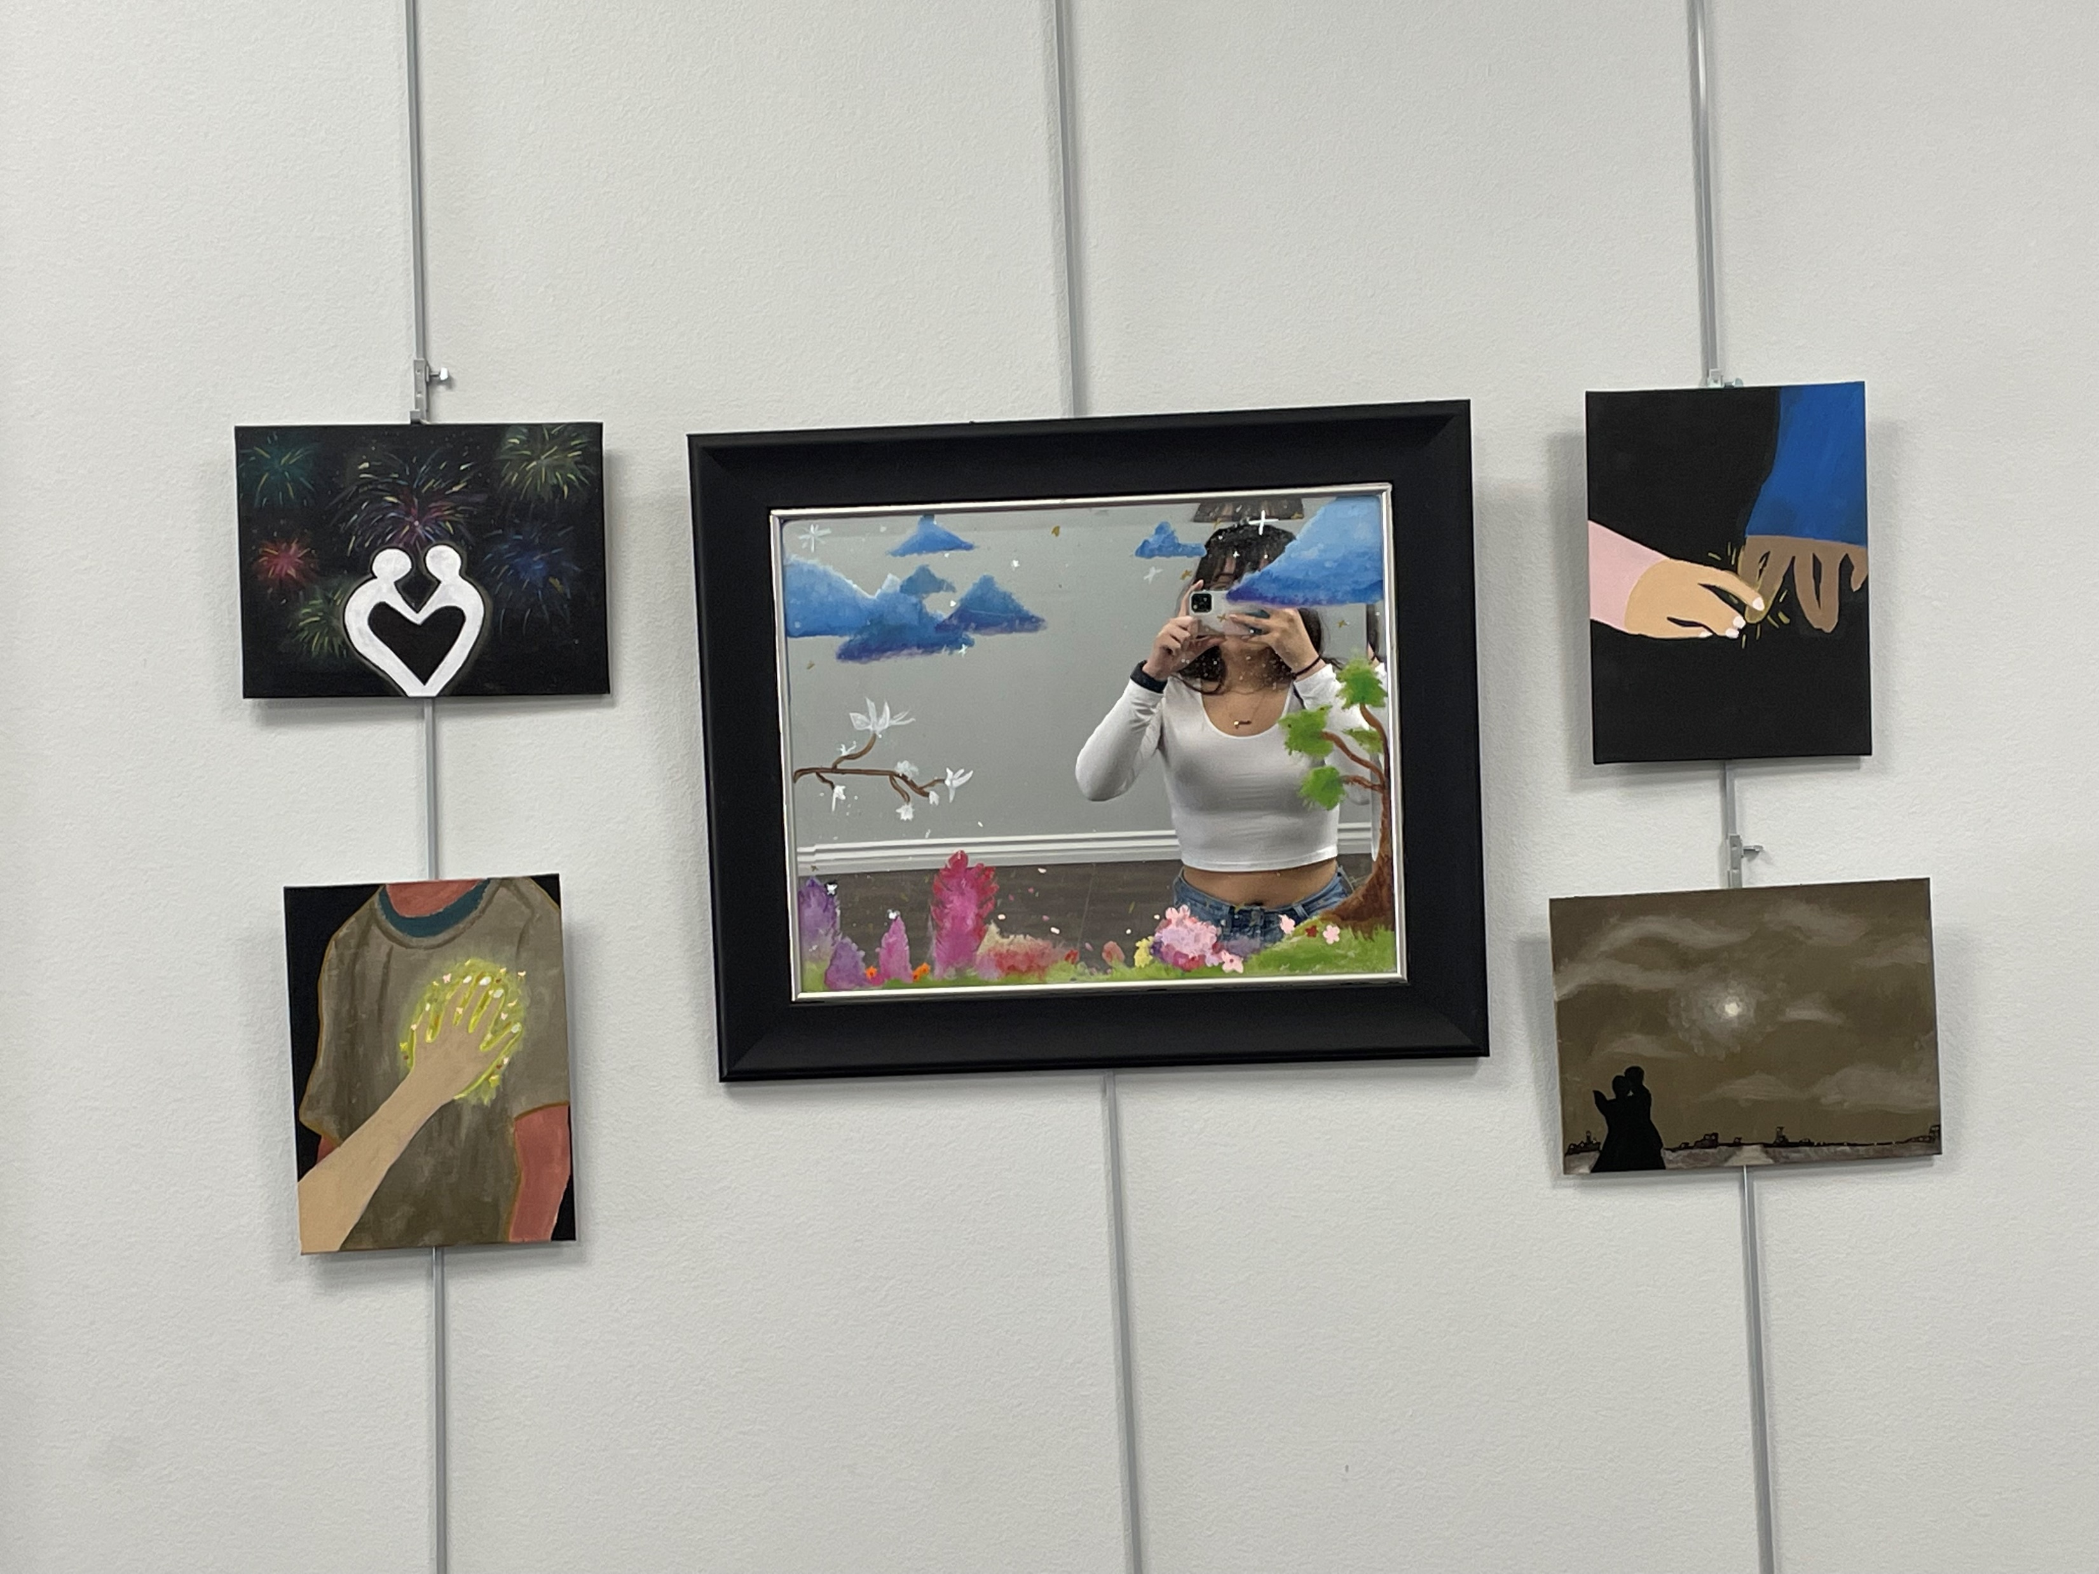
Exhibition Overview Photos

Slide 4
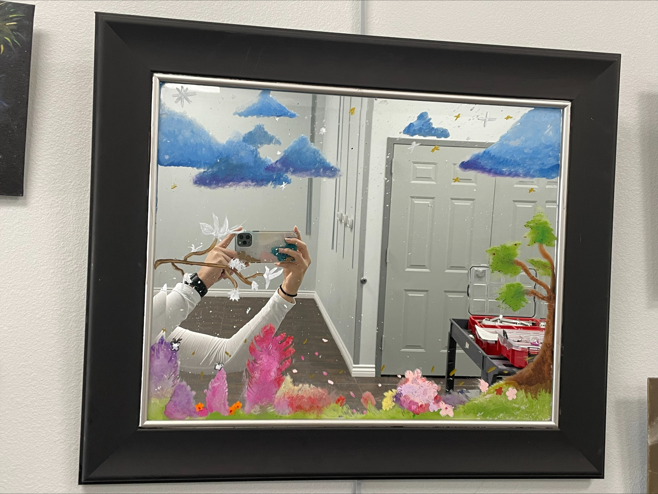
Beauty Within
Exhibition Text
Title: Beauty Within
Media: Acrylic Paint
Size:
With this artwork I was inspired by a few classmates who I had previously seen painted on mirrors. I thought the Idea was cool and I decided to come up with my own. With this art piece I knew I wanted to give some message of beauty and self-love. Mirrors tend to be associated with beauty, but to me I often associate them with insecurity. Growing up I used to stare at myself in the mirror and point out what I didn’t like about myself. I decided to paint a beautiful scenery so that when I look at this art piece, I can associate beauty with mirrors again. Flowers and clouds have always been something extremely eye catching to me and by incorporating that into this painting I feel that I can give the message that beauty is eye catching. Making this artwork the centerpiece allows the audience to interpret that beauty and self-love are the fundamental piece of young love, a person must because able to love themself before being able to love someone else.

Slide 5
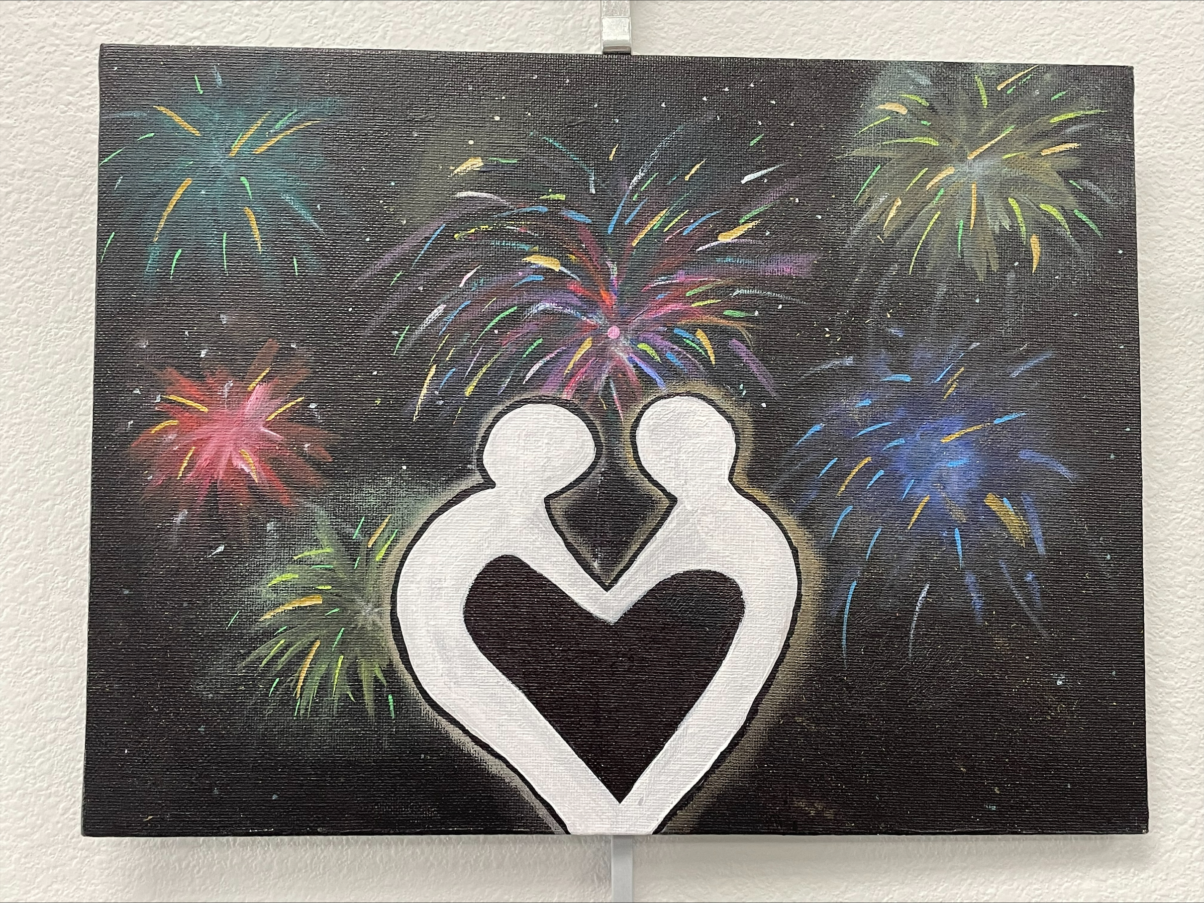
Sparks
Exhibition Text
Title: Sparks
Media: Acrylic paint
Size: 30.48x 22.86(cm)
My artwork is supposed to briefly outline what the first few stages in a relationship are like. Meaning the sparks you feel and the innocence of it. You become incapsulated by that special person and suddenly all you want to do is be around them and your whole world becomes them. The fireworks in the background symbolize the rush of adrenaline and excitement that come with sharing a special moment with your significant other. The fireworks however are dull symbolizing the potential for deep and meaningful connections.

Slide 6
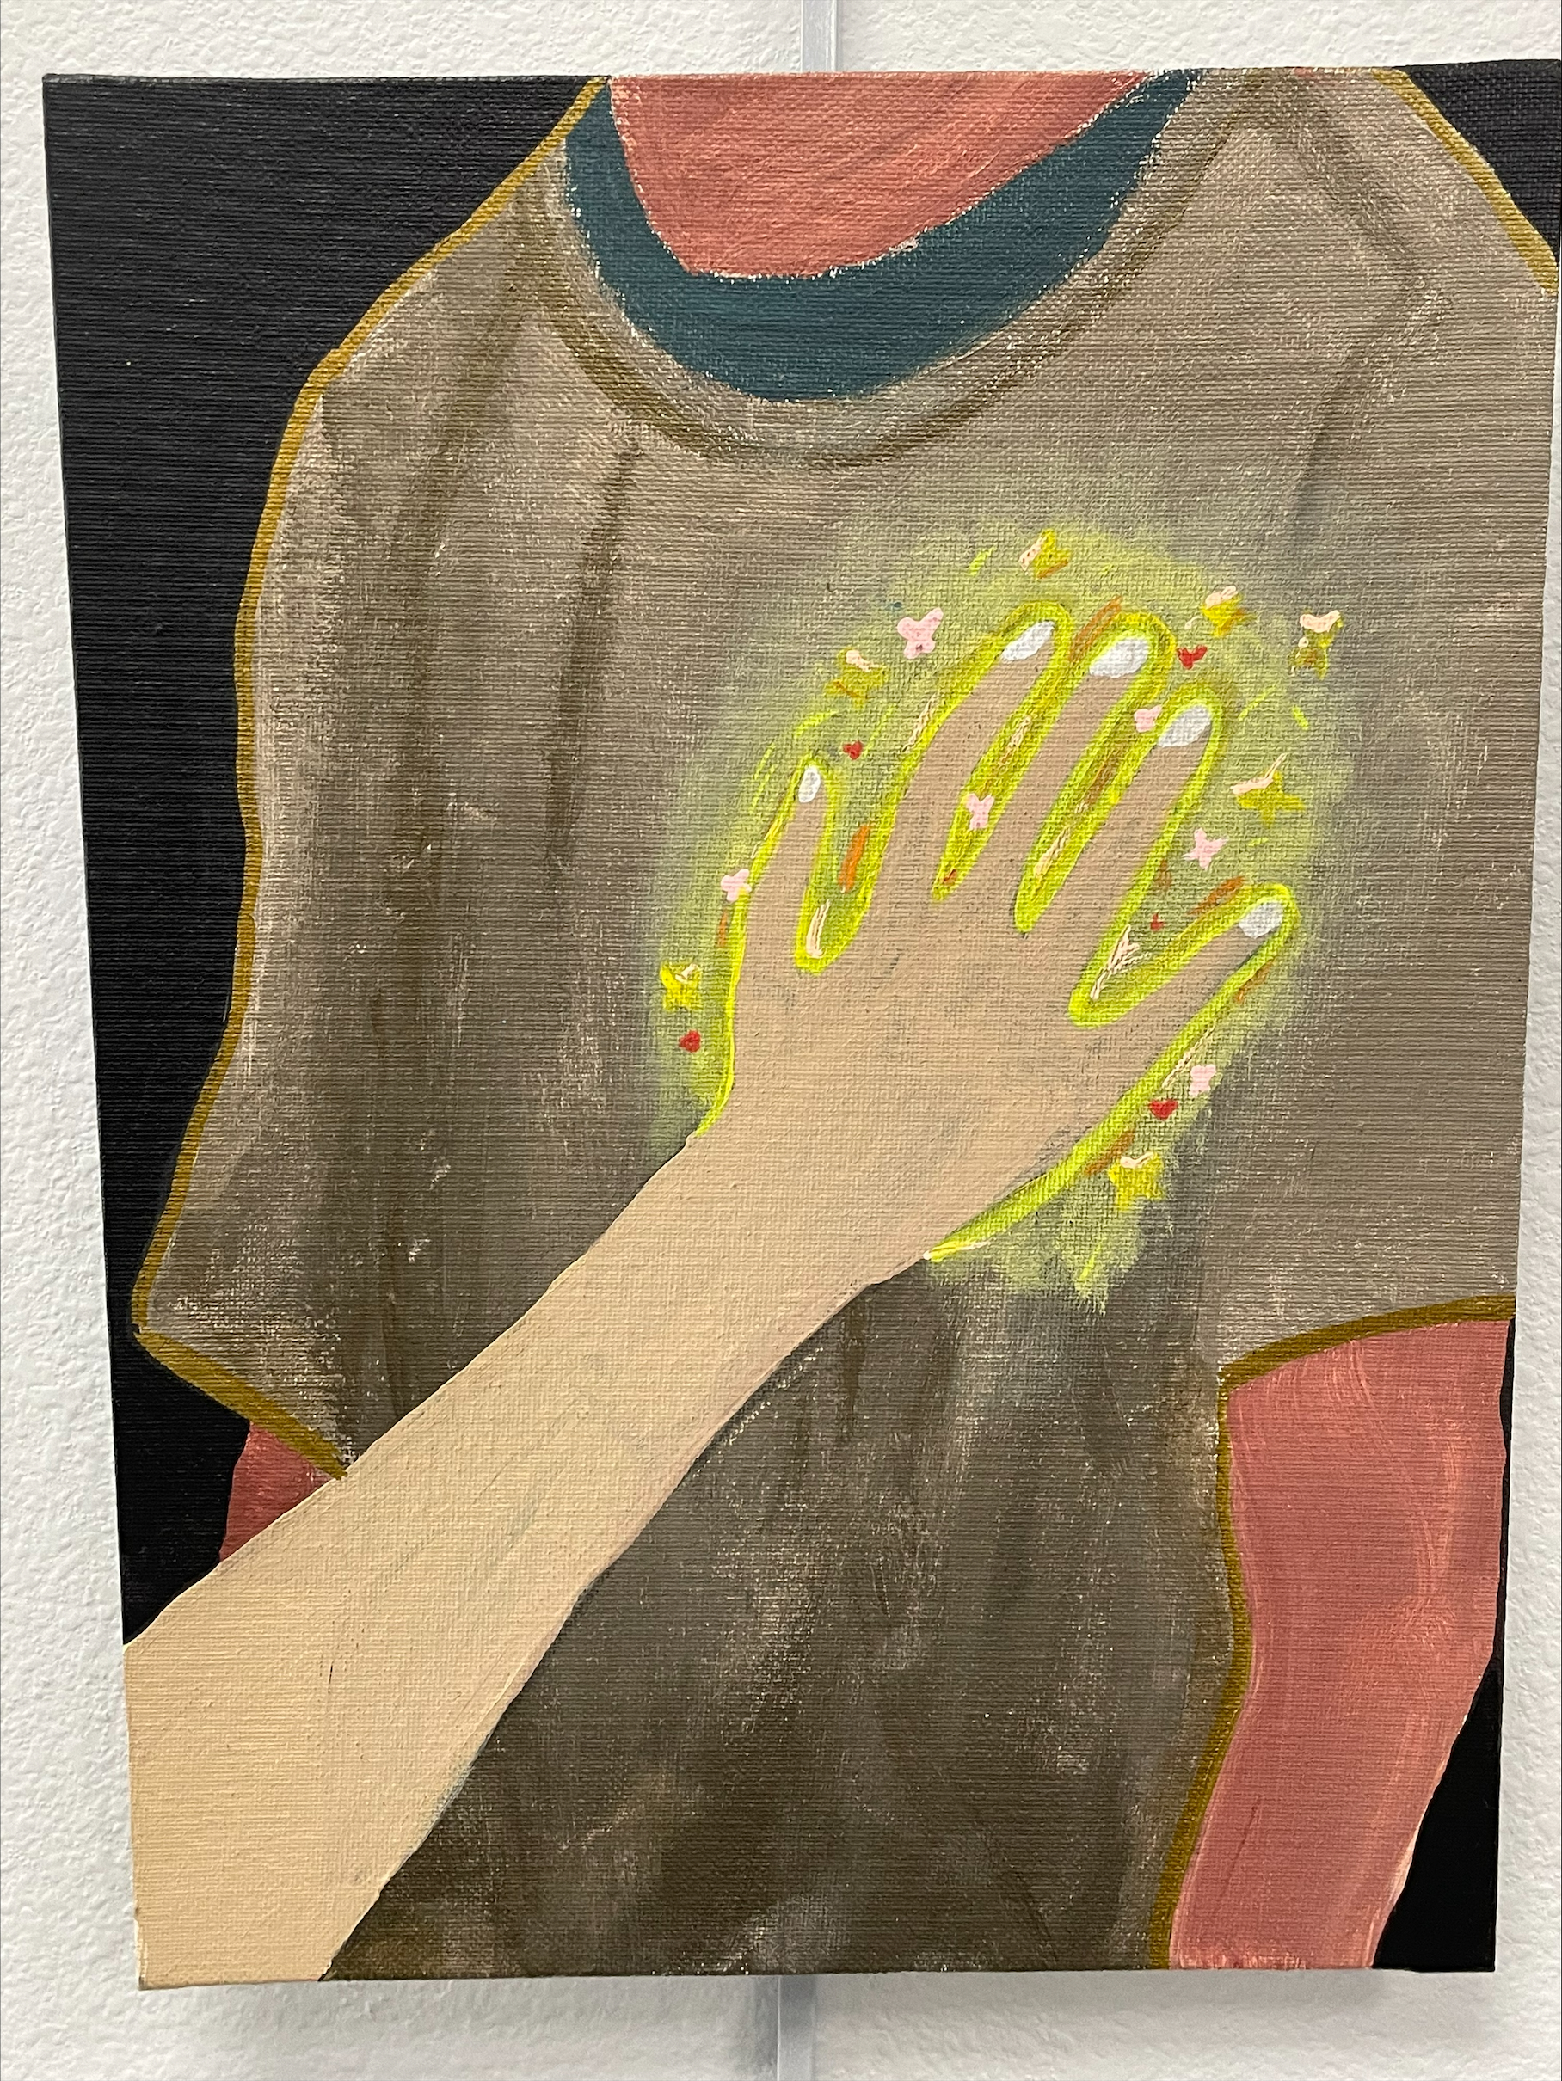
Butterflies
Exhibition Text
Title: Butterflies
Media: Acrylic paint
Size: 30.48x22.86(cm)
This artwork focuses on the significance and impact a touch may have on someone, a simple touch can be a special moment between two people where they come together in an innocent and caring way. Causing ease and calmness to the person but also nervous anticipation and that fluttery feeling of excitement which is being represented by the butterflies. The warm tones represent the calmness of the scenery while the bright colors around the hand bring focus to that innocent touch, which is the main focus of the artwork.

Slide 7
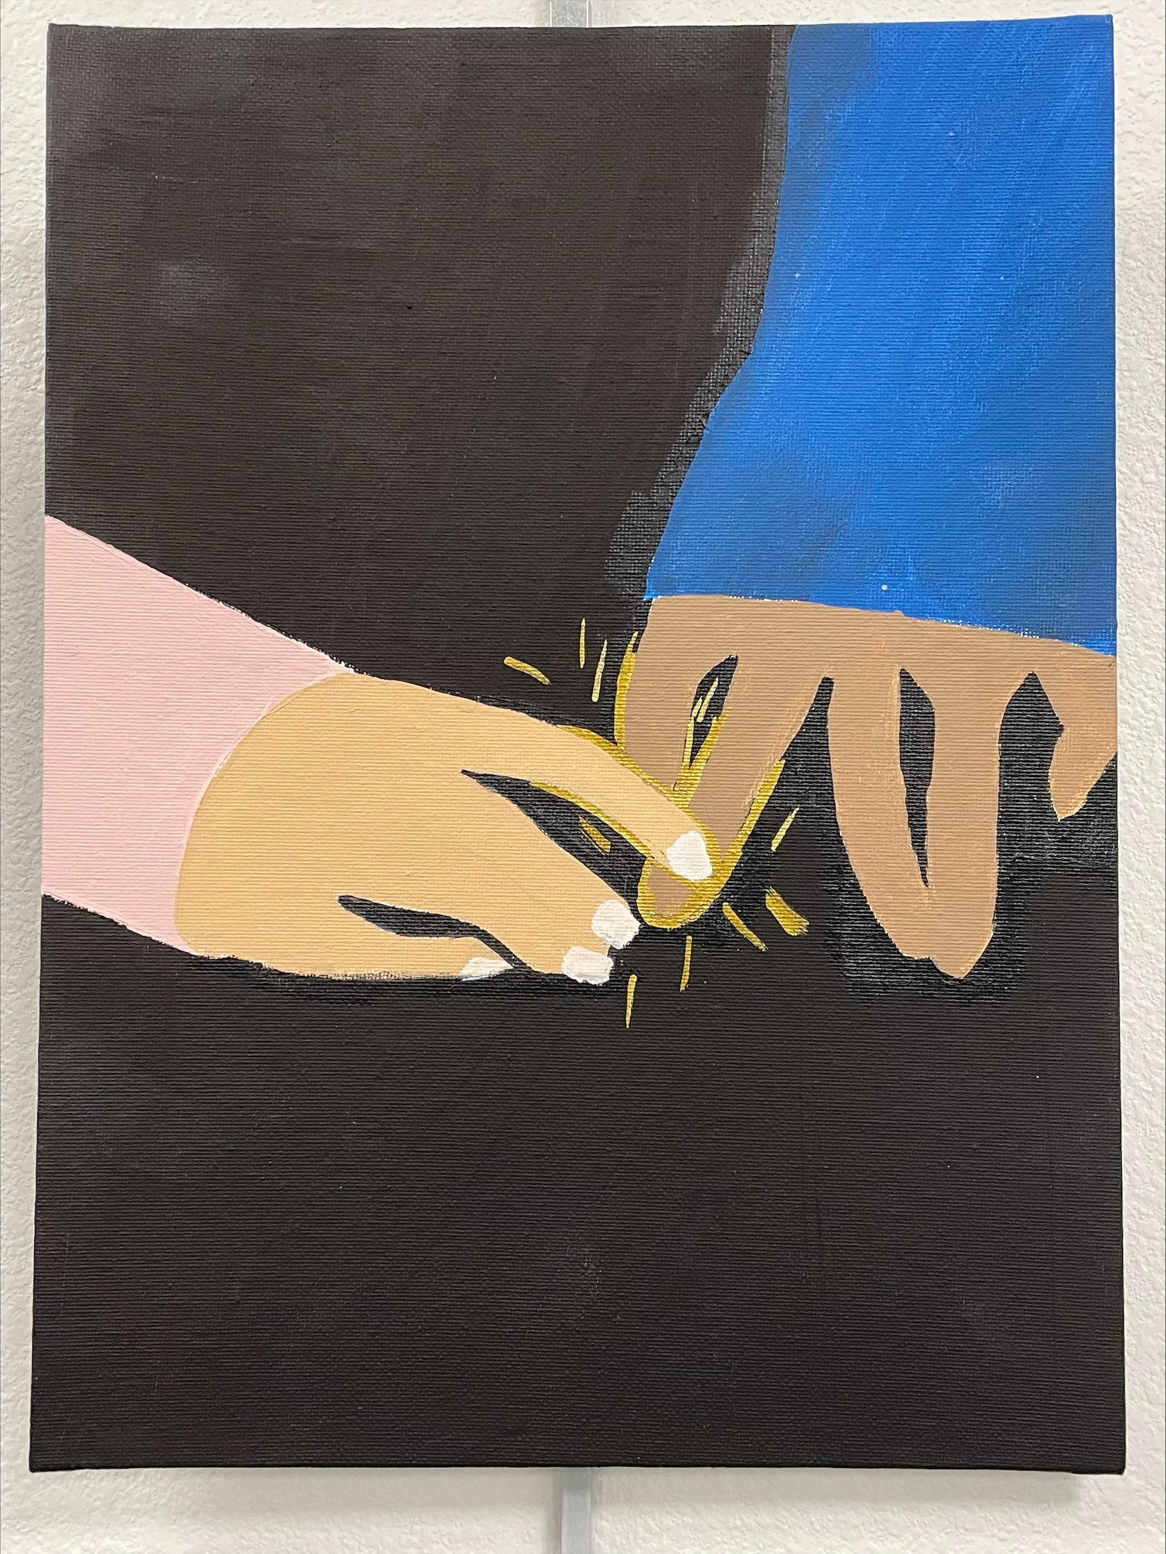
The touch
Exhibition text
Title: The touch
Media: Acrylic paint
Size: 30.48x22.86(cm)
This artwork represents the moment someone reaches out to their significant other in a compassionate way; this touch isn’t necessarily romantic but it’s a gesture of support and eases tension. There is an uncertainty of whom is reaching out to whom, showcasing that really both sides can be supporting of one each other. Young love is centered around the idea that there should be support for one another in difficult situations. The contradicting colors of blue and pink showcase that these two people are of different backgrounds but are united by fingertips and a gold outline. The gold symbolizes calmness and ease.

Slide 8
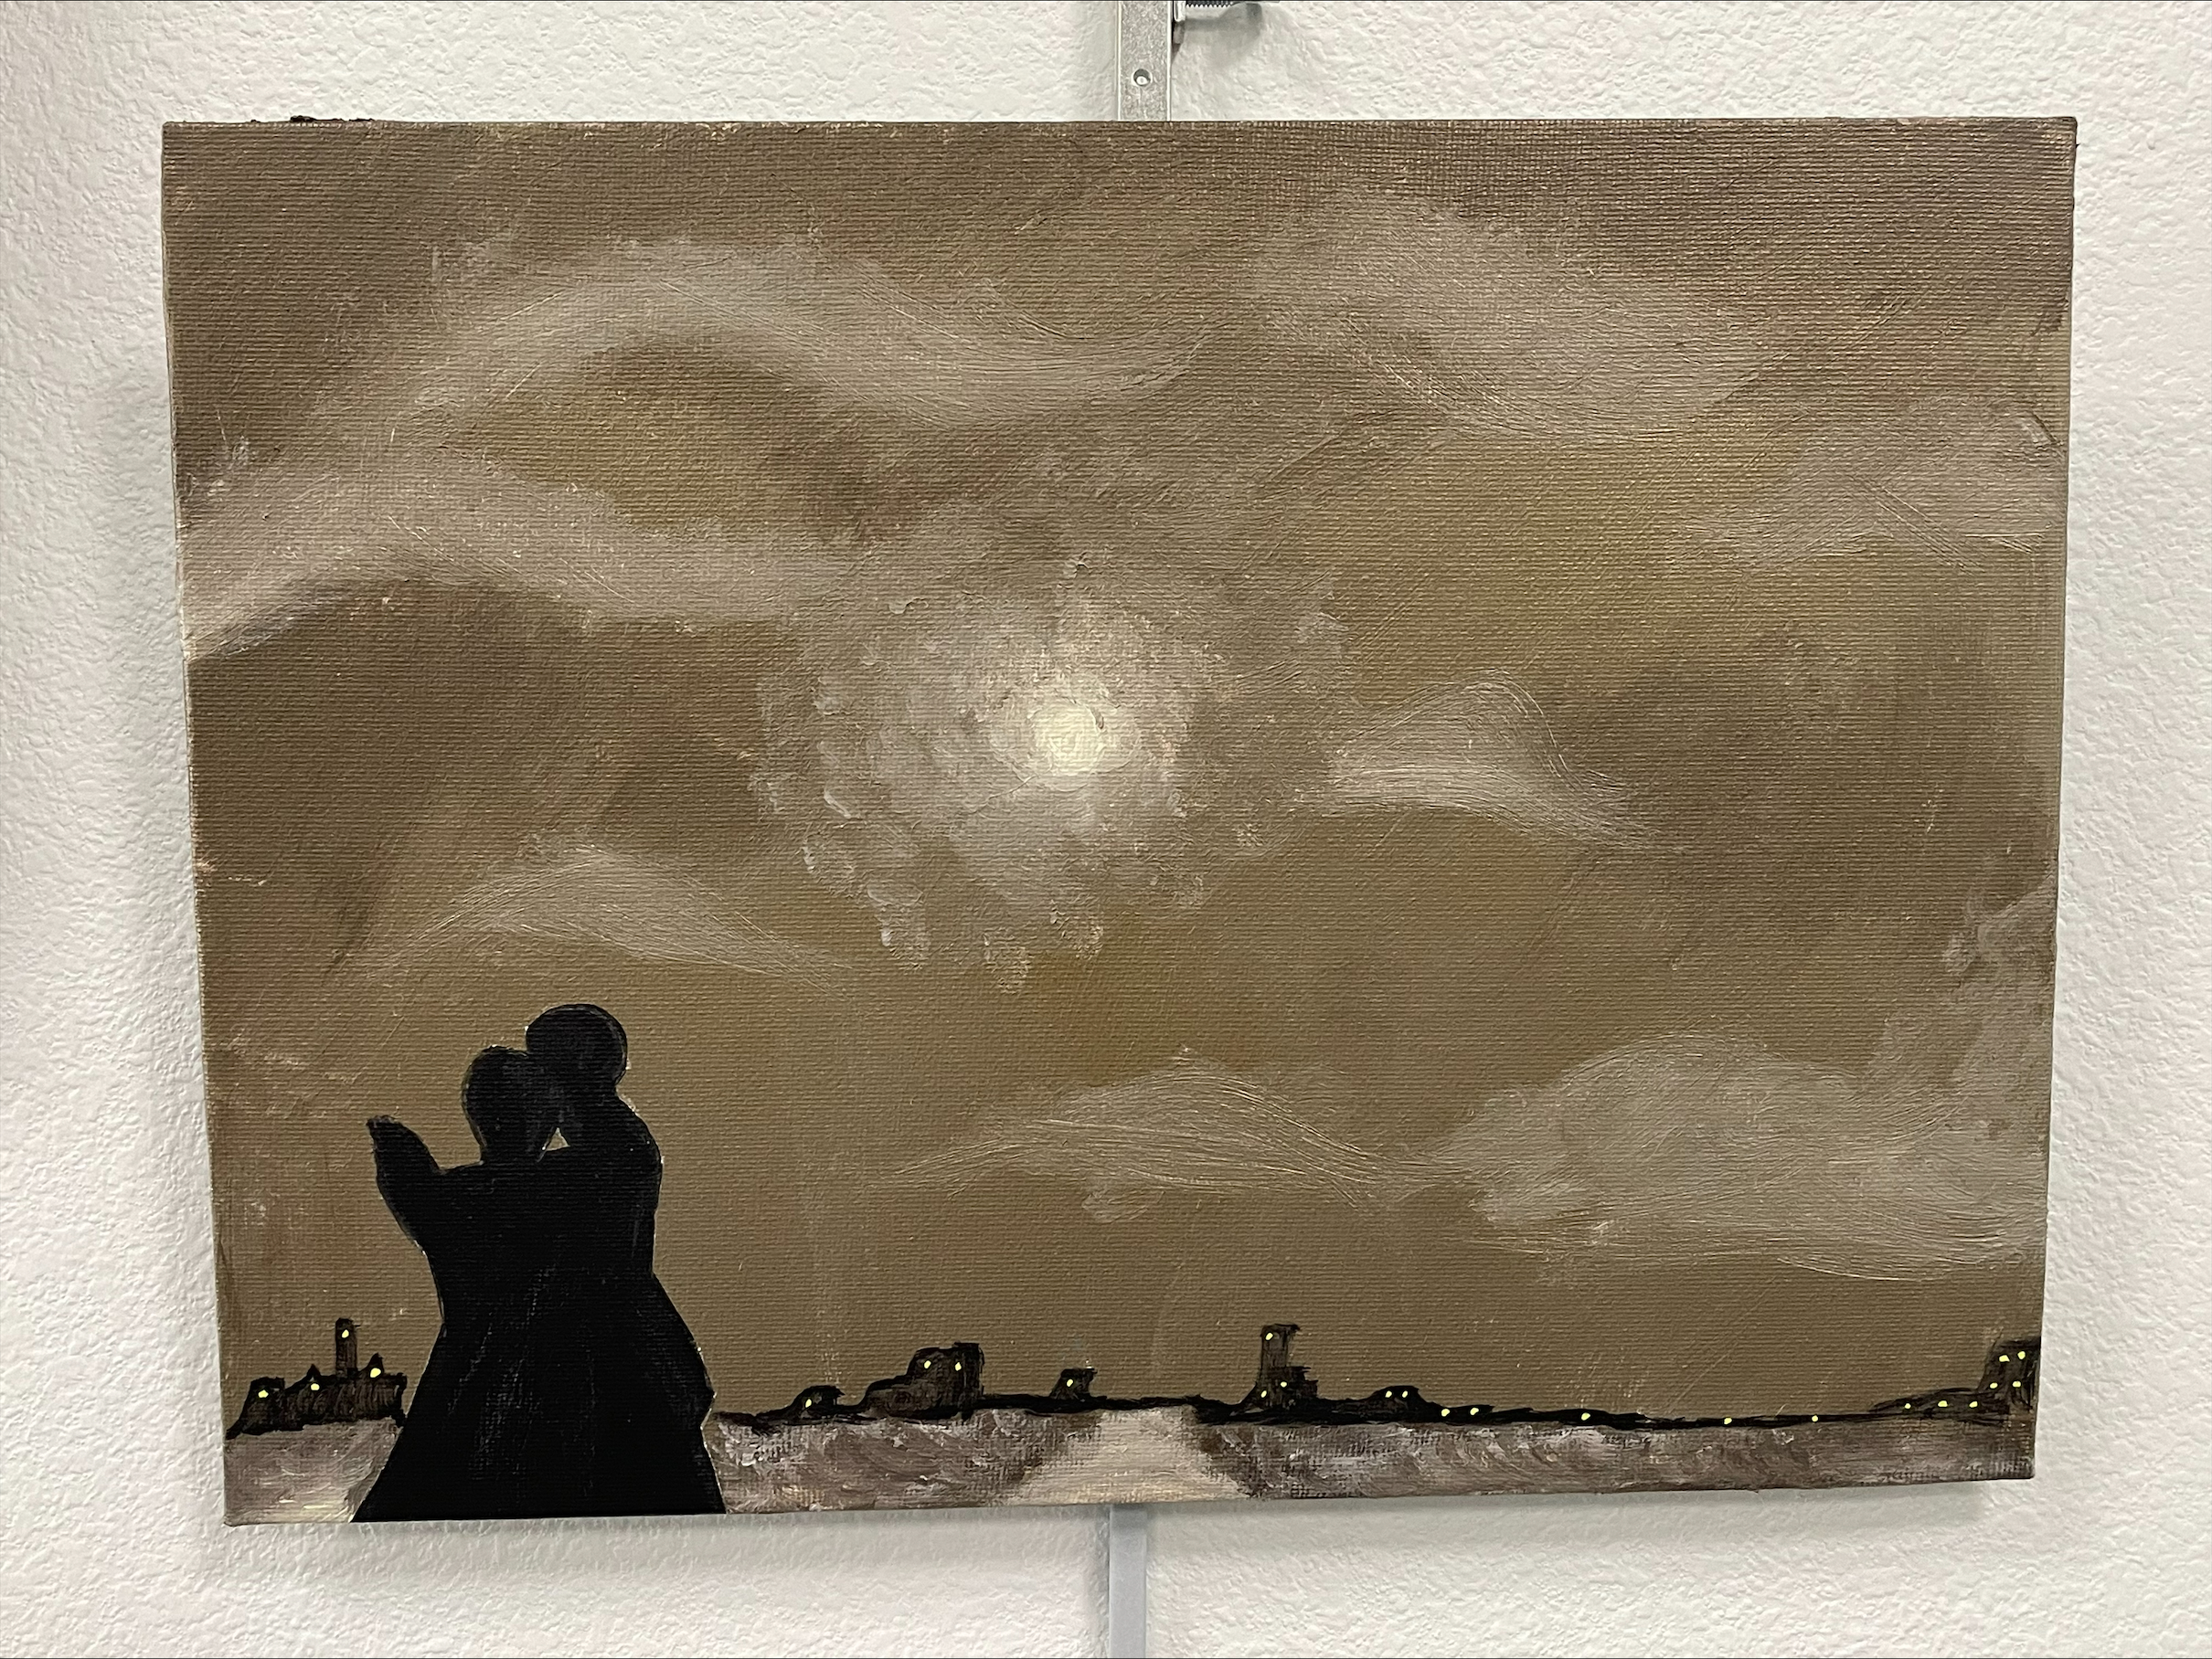
Just us
Exhibition Text
Title: Just us
Media: Acrylic paint
Size: 30.48x22.86(cm)
This artwork showcases two people sharing a special moment with each other, one that can be so overlooked but make you feel like you’re the only two in that moment, slow dancing. There’s a sense of intimacy and connection that comes from slow dancing, the two individuals are depicted as being lost in the moment, as their bodies intertwine and eyes are locked on each other, their surrounding fading away as its just them two sharing this moment. The background is calm with the color gold but the hints of white represent hazy clouds, signifying an almost cool like emotion. The perspective of the city in the background being small is meant to signify how emotionally involved the two people are, so much so that they believe they are the only ones in that moment.

