Slide 1
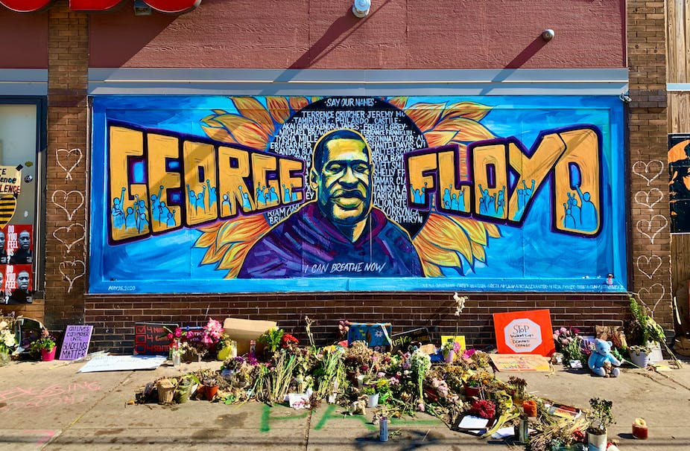
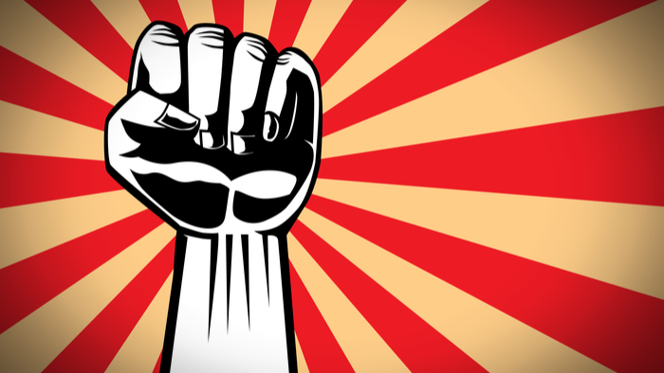
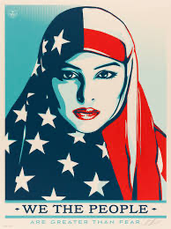
Activism in Art
Art to Integrate, Not Divide
Art as a way of cultivating empathy
Artists whose works have reacted and reflected on themes like violence, oppression, and injustice.

Slide 2
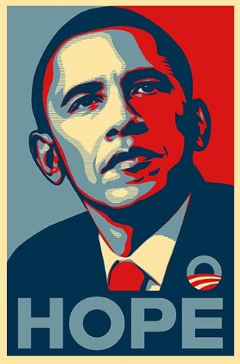
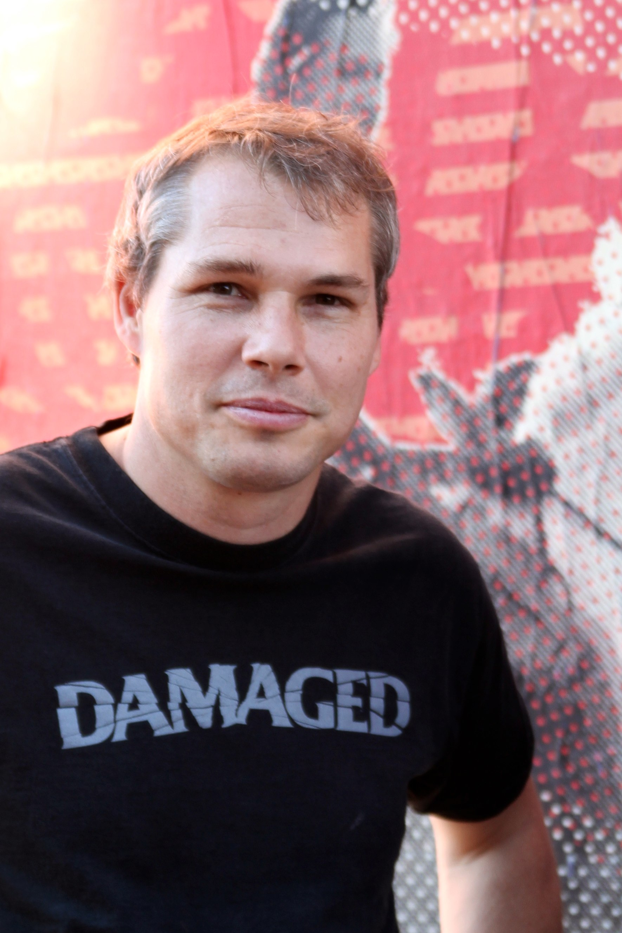
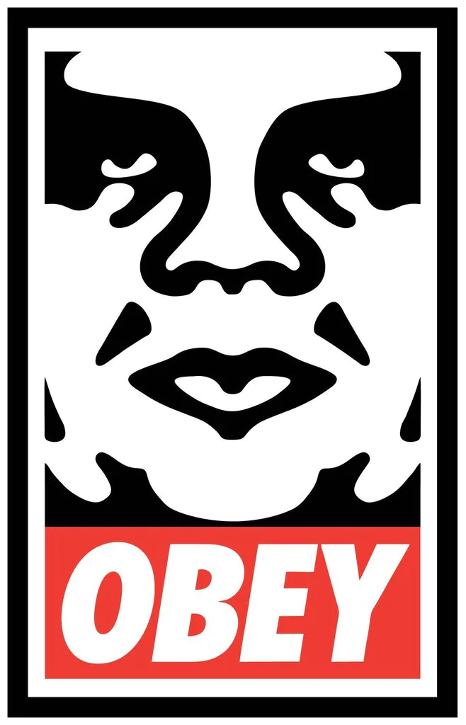
Shepard Fairey
American graphic artist
and social activist
who is part of the Street
Art movement
His art aims to send messages about politics, human rights, war, and environmental issues. He is considered one of today's most influential street artists. His
signature digital artworks, posters, murals, stickers, and clothing items encourage questions about the public space and expected behaviors.

Slide 3
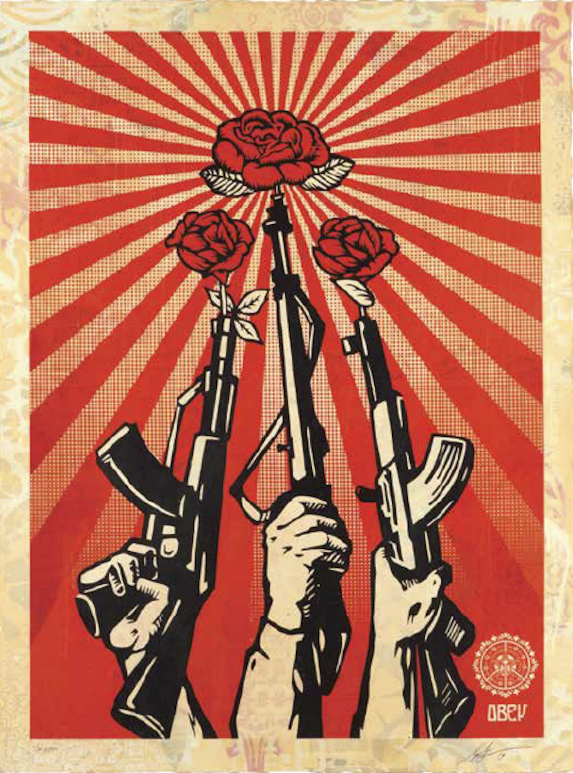

Slide 4
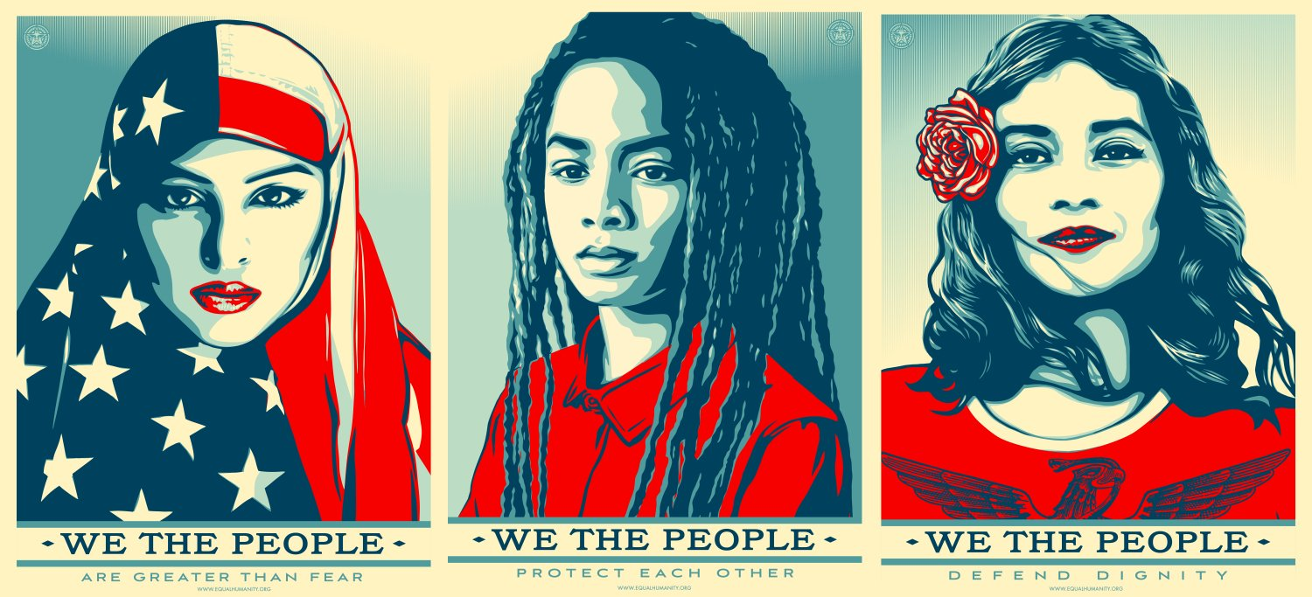

Slide 5
Various stages/actions of Fairey's printmaking process:
Making a printable surface: collaging papers with history and painting over them.
Creating stencils for use with screen printing or spray paint.
Layering of imagery
Sanding and Varnishing

Slide 6
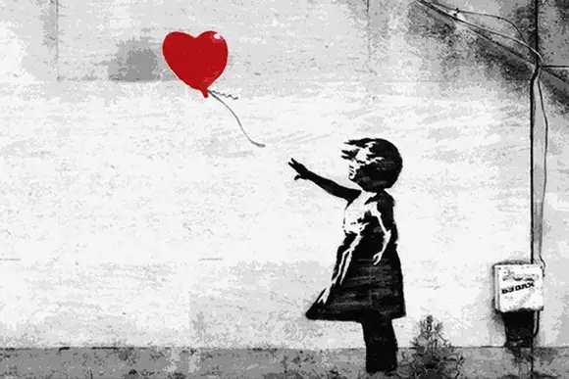
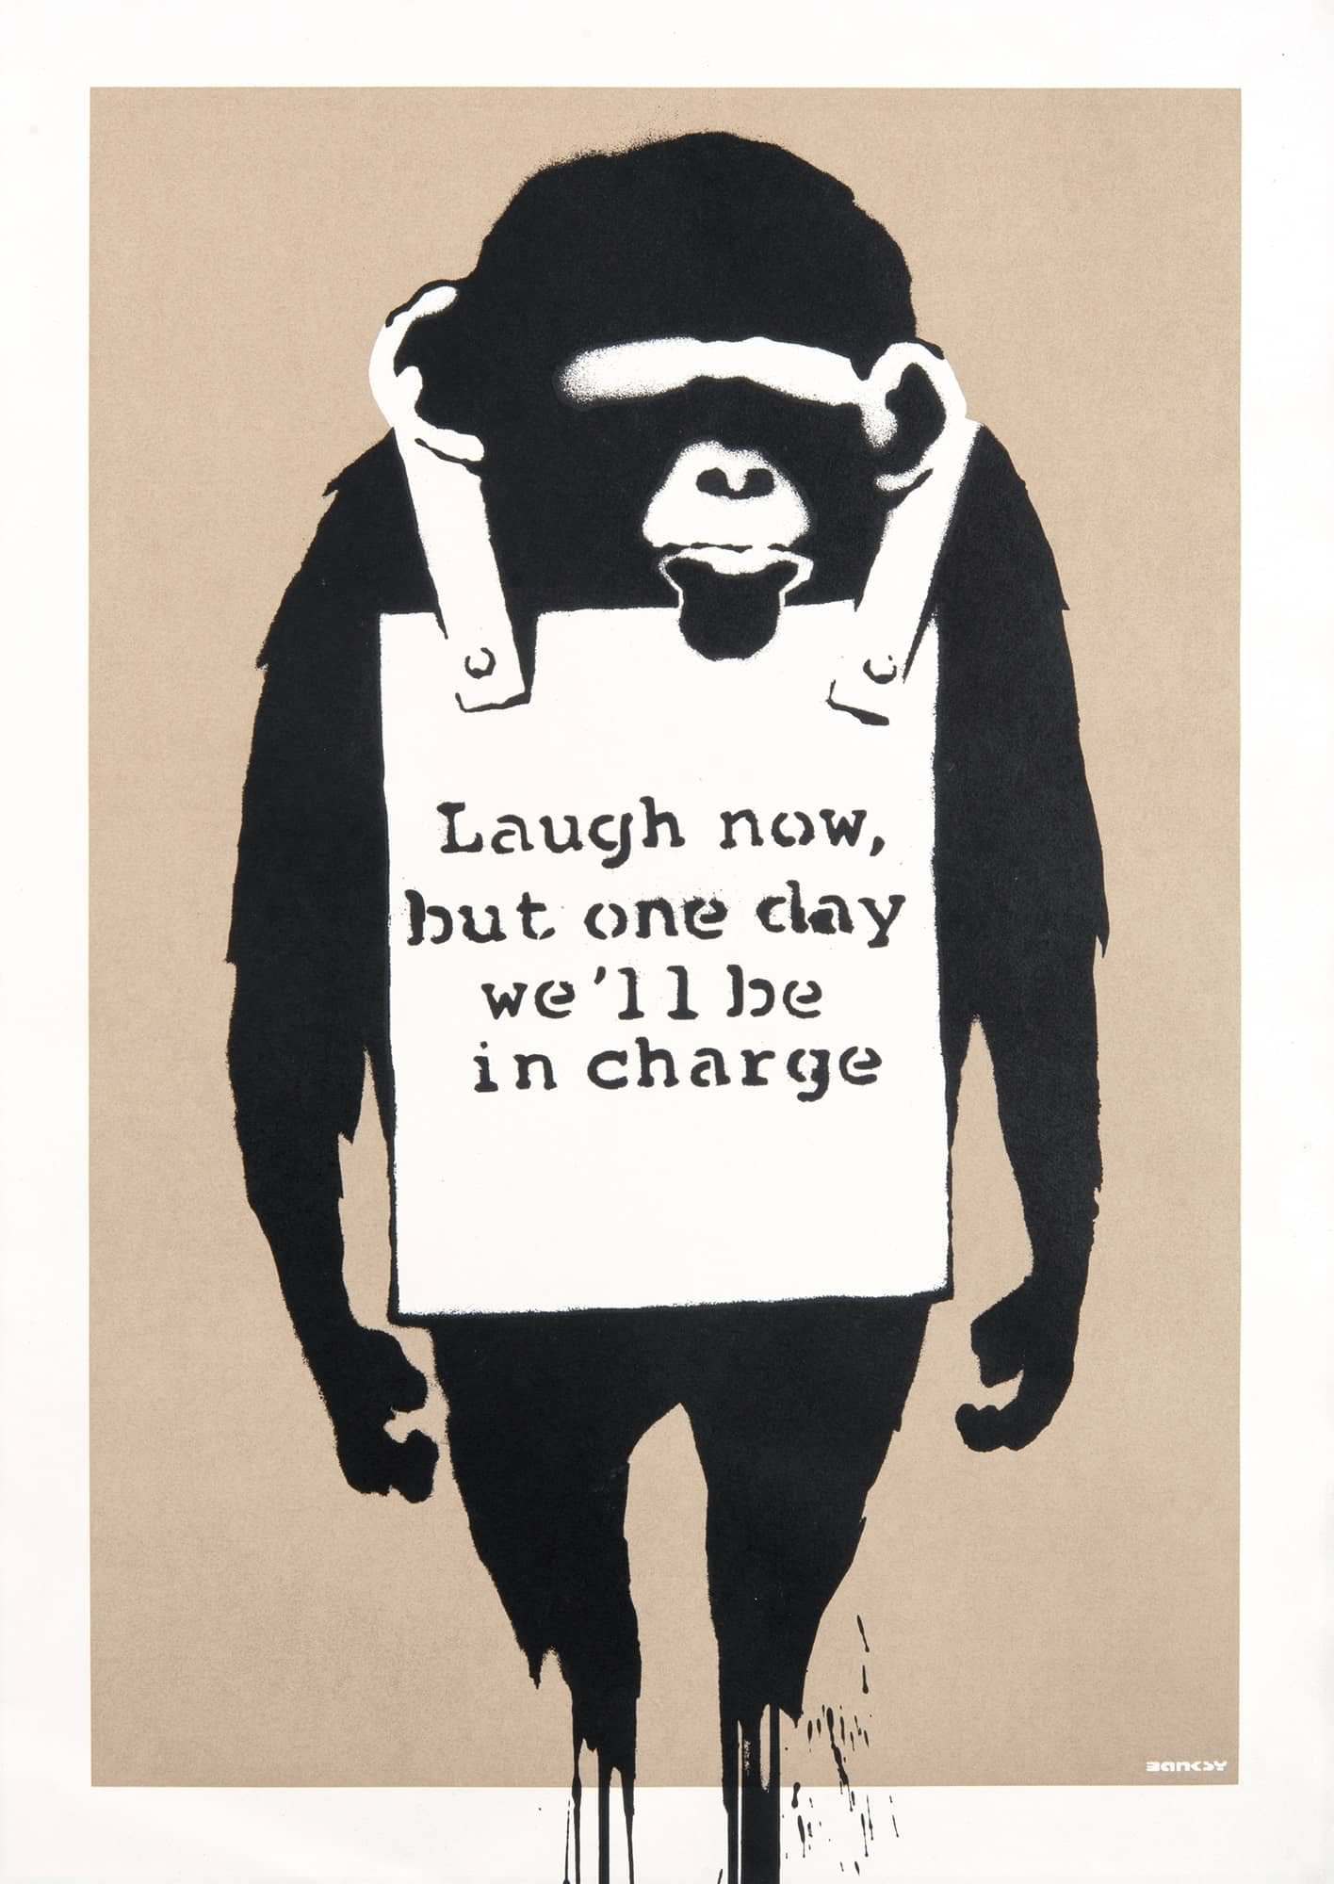
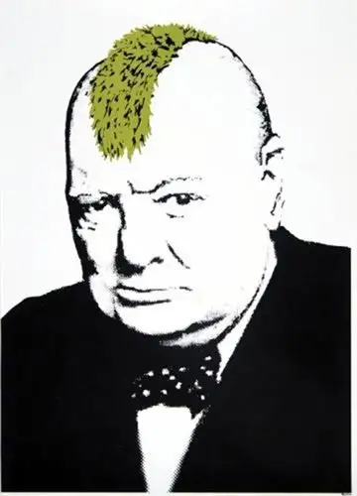
Banksy
A defining graffitist of our time, known for his stenciling style, which he developed in the late 1980s as a way to stay safe on the streets and not get arrested.
He is one of the most sought-after artists of the present and a cultural icon. At the same time, the artist's personally identity remains unknown.

Slide 7
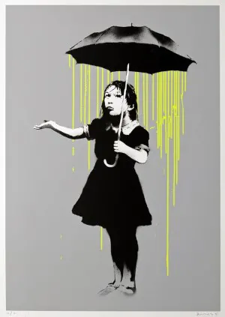
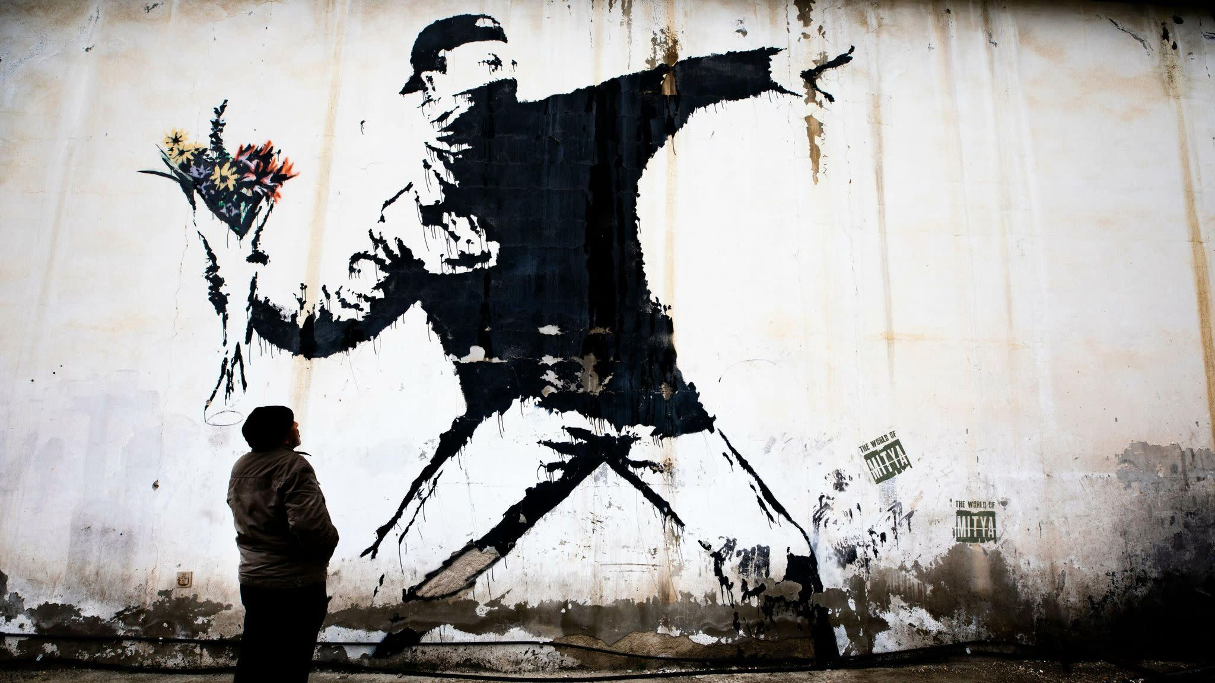
A crucial pillar of Banksy's activism is his stance against all forms of war and violence.

Slide 8
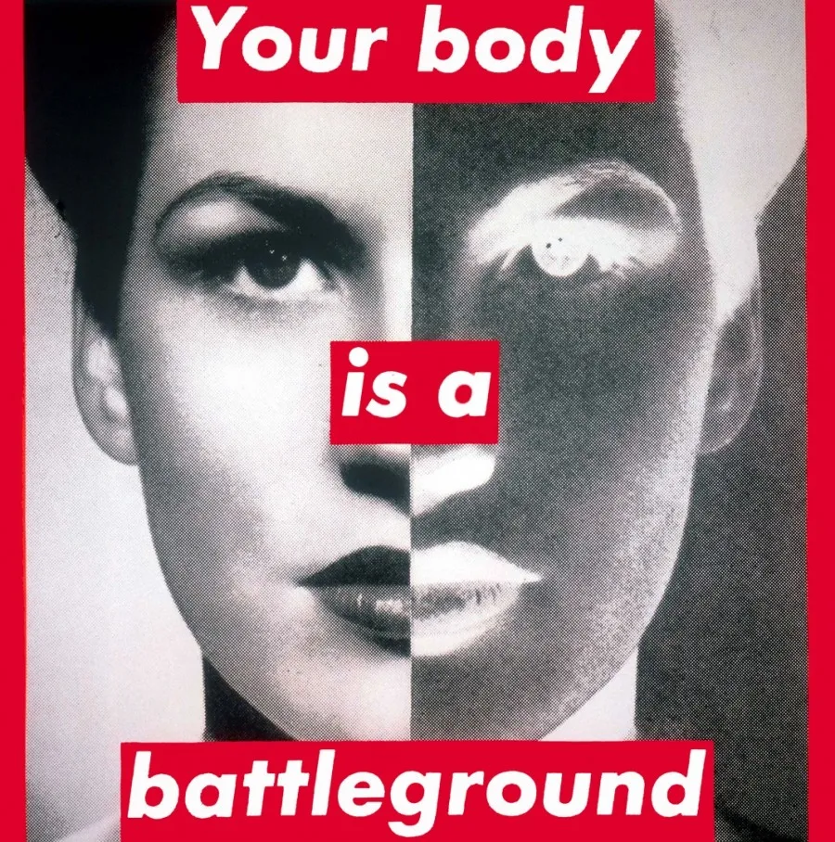
Barbara Kruger
American conceptual artist Barbara Kruger places catchy satirical phrases over mass media images to challenge notions of power, identity, and sexuality.
By using text as a crucial communication tool in her artistic practice, Barbara Kruger explores the stereotypes and behaviors of consumerism

Slide 9
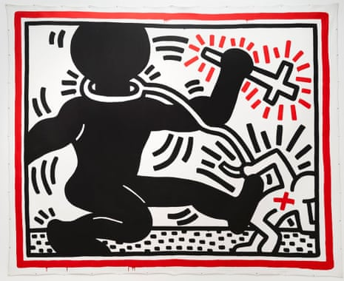
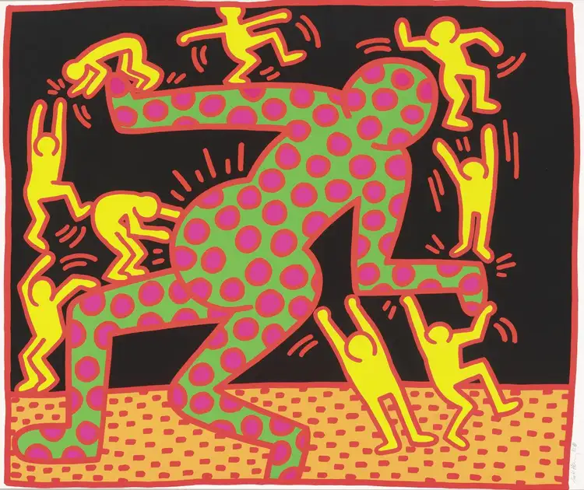
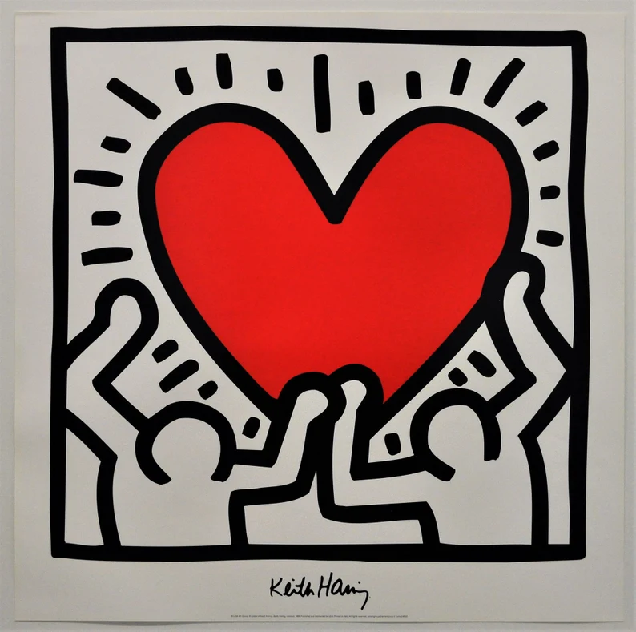
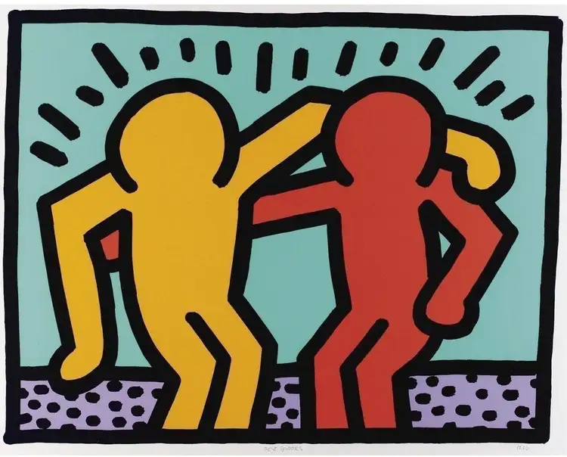
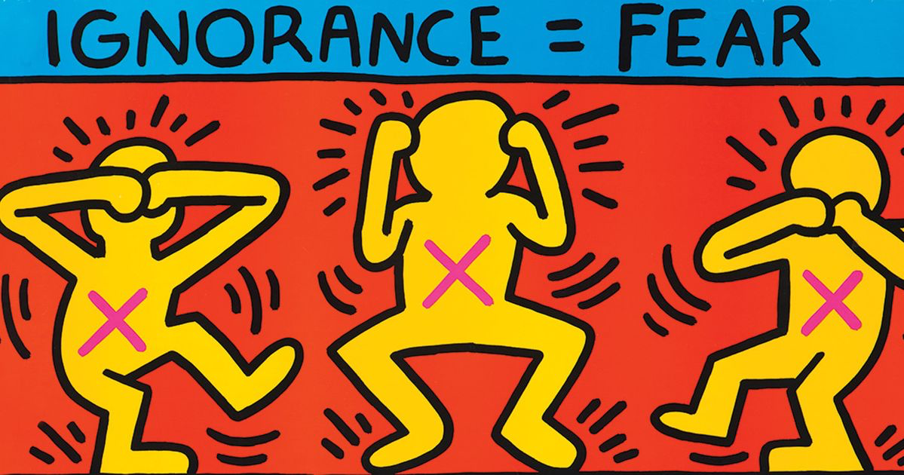
Keith Haring
He was determined to give a
voice to those who felt silenced,

Slide 10
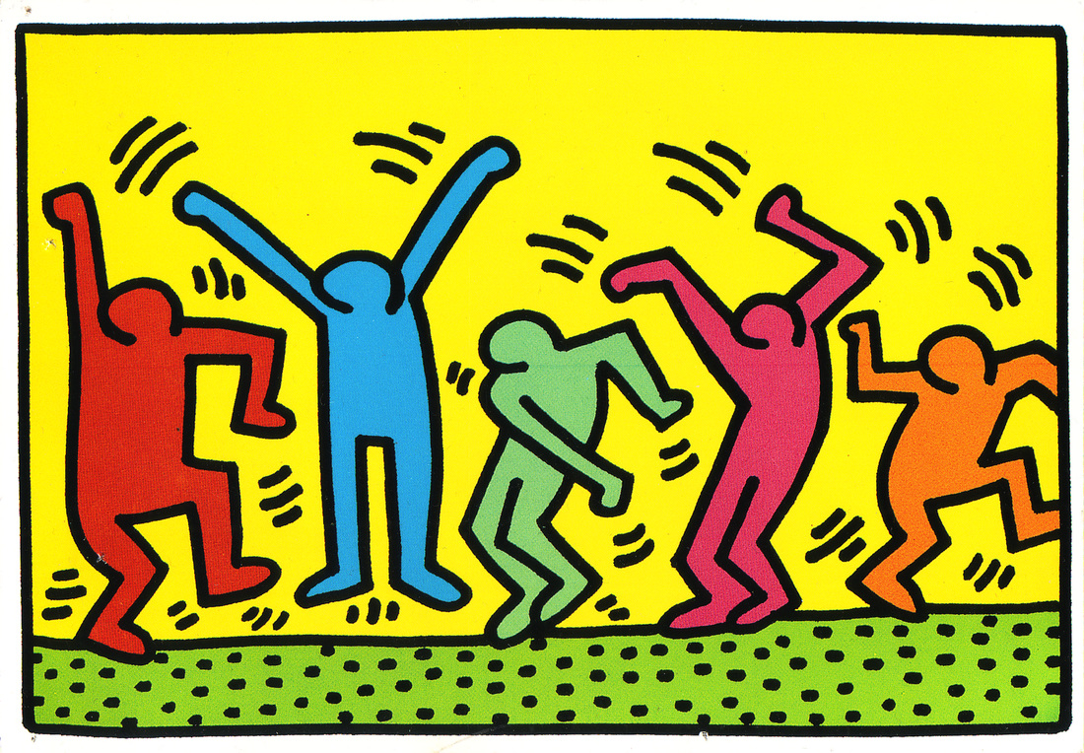
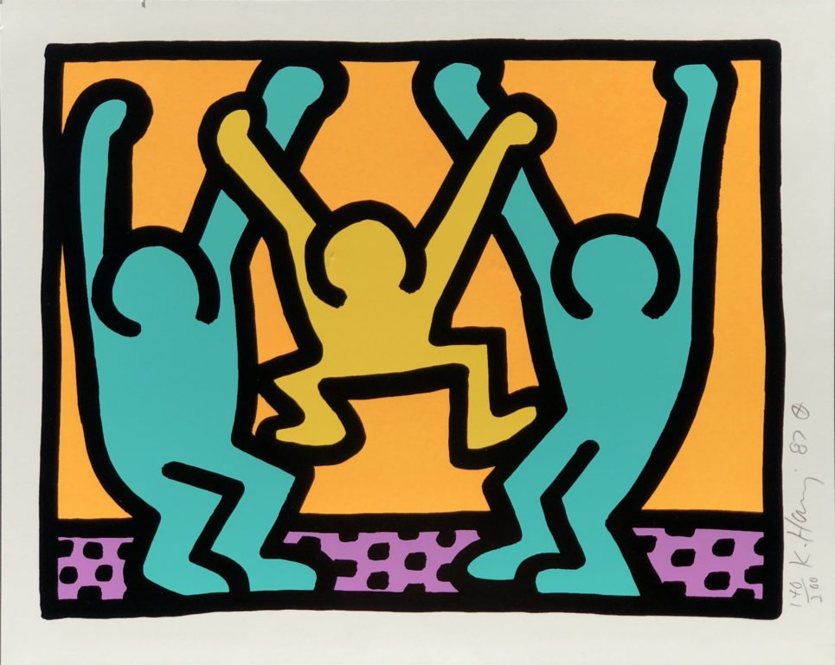
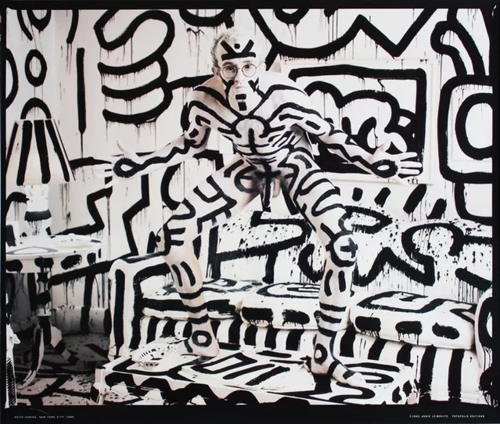
Keith Haring (1958-1990) was the first professionally-trained artist to use graffiti-inspired style in his art. He started painting his trademark images on New York's subway walls in 1978, and the people who rode the subway soon came to recognize and appreciate his work.

Slide 11
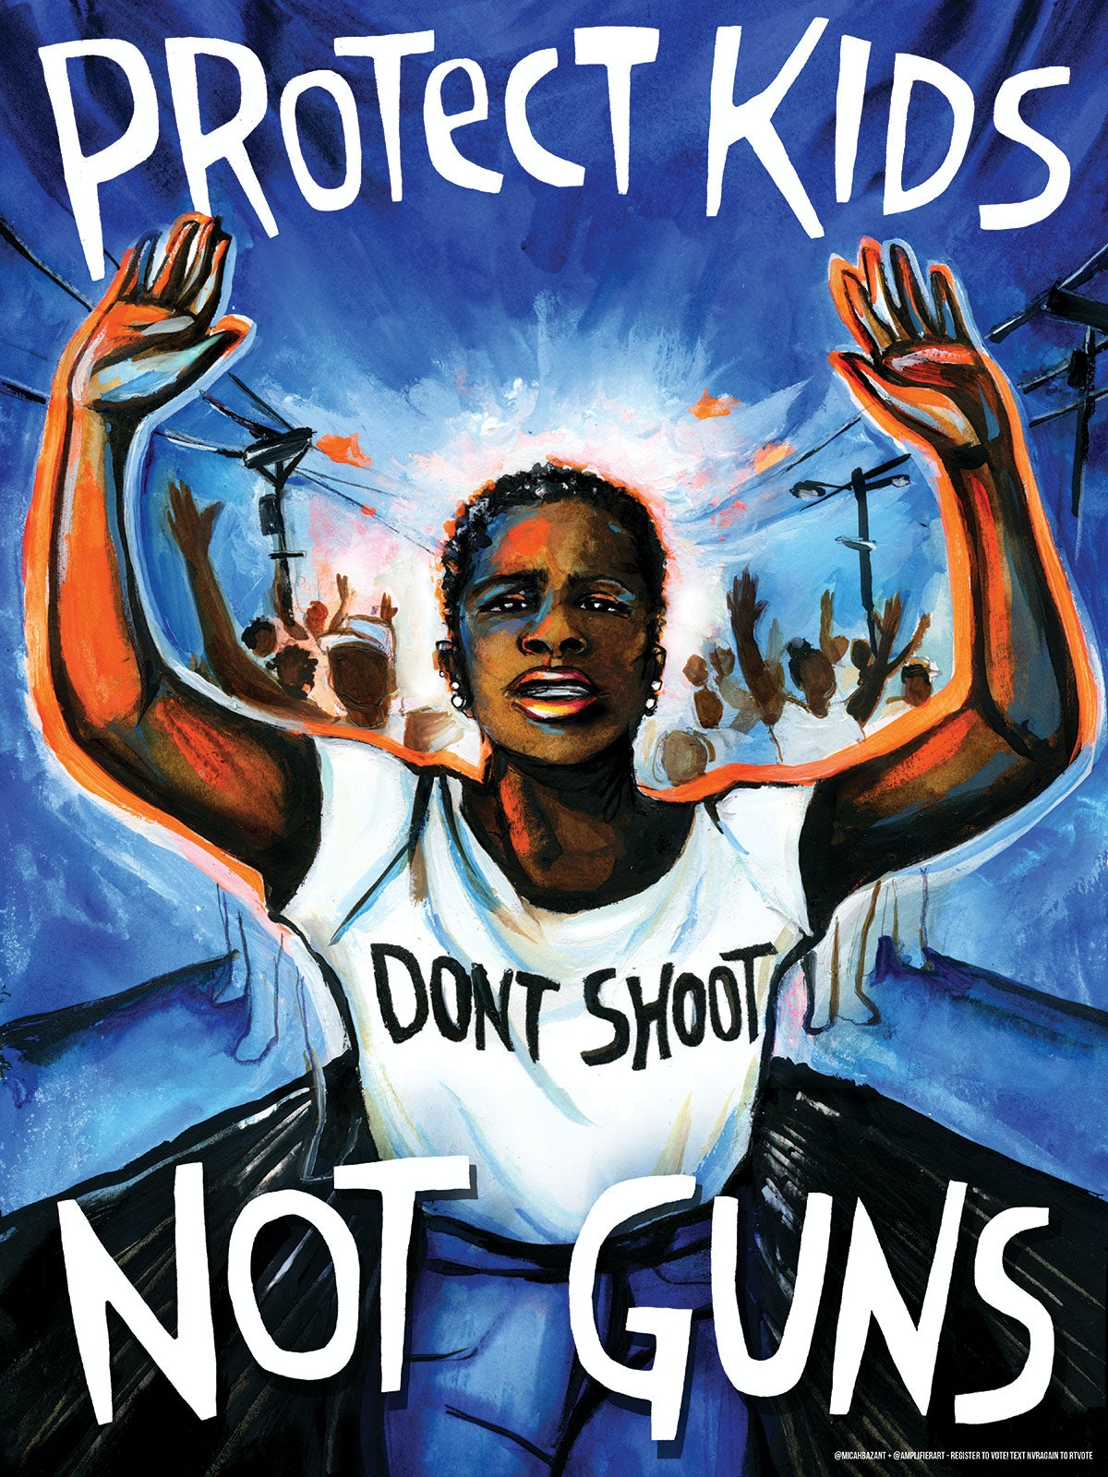
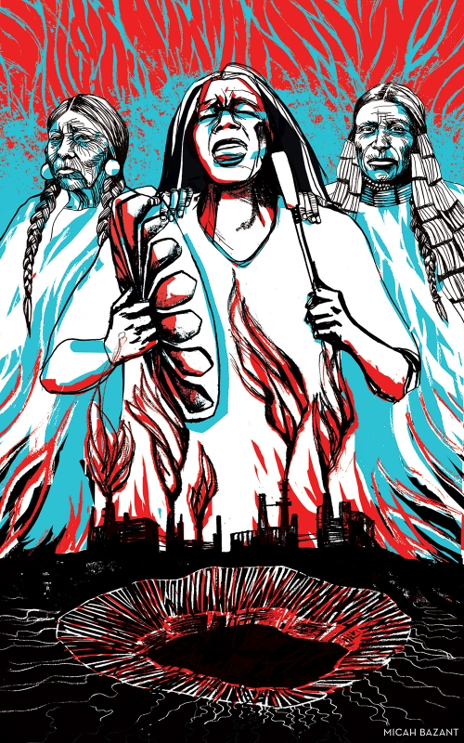
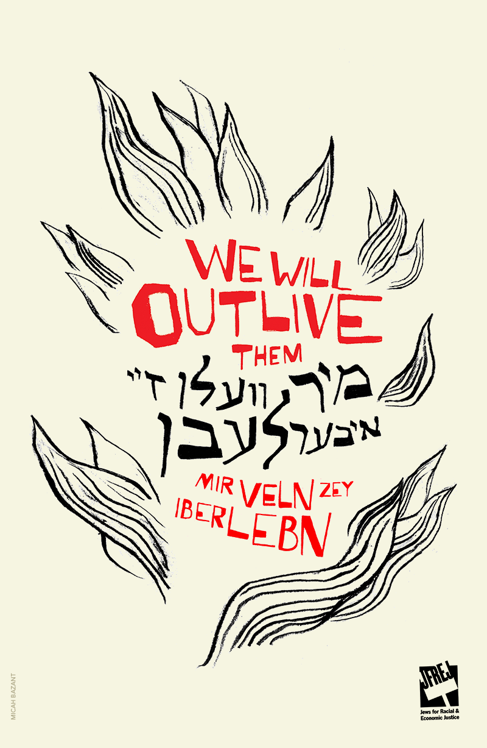
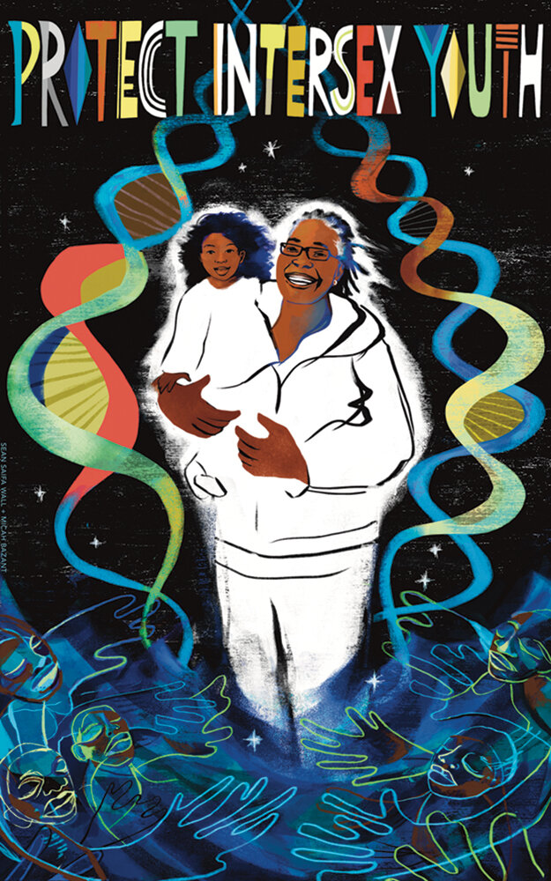
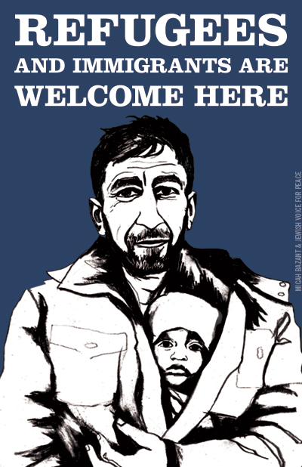
Micah Bazant
This 2018 poster by Micah Bazant for Amplifier created for March For Our Lives, a student-led protest campaigning for stricter gun laws

Slide 12
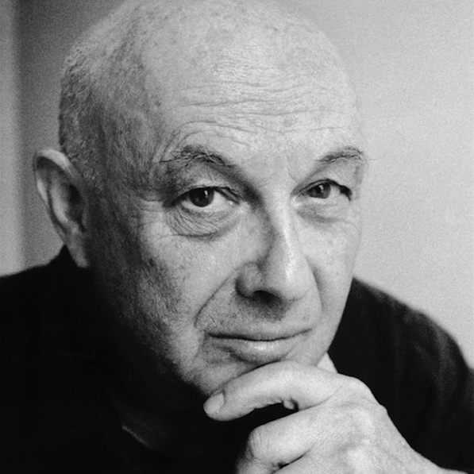
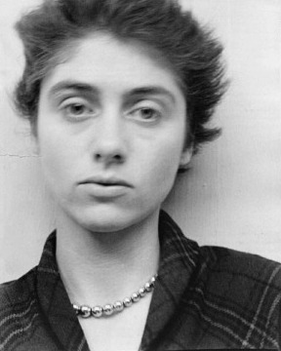
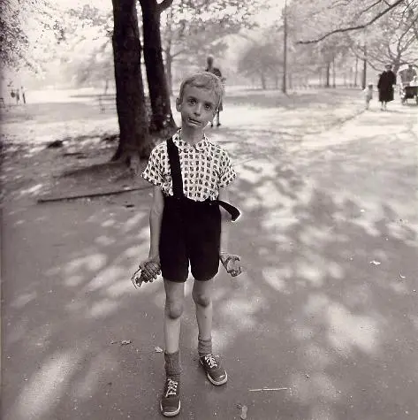
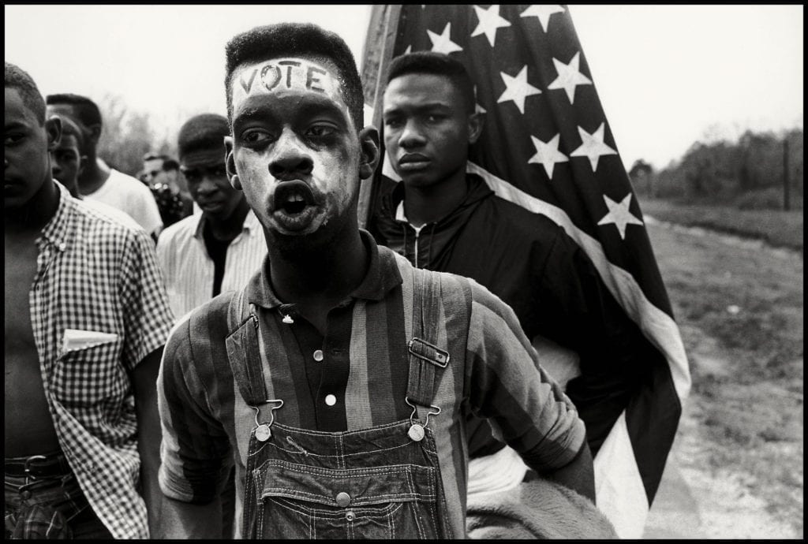
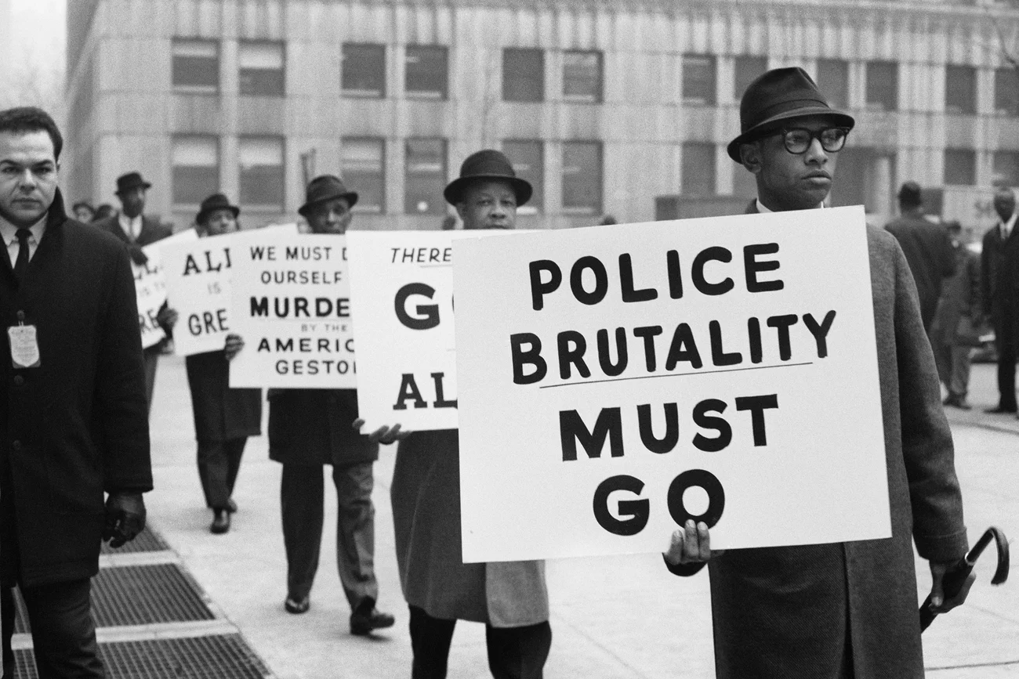
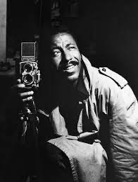
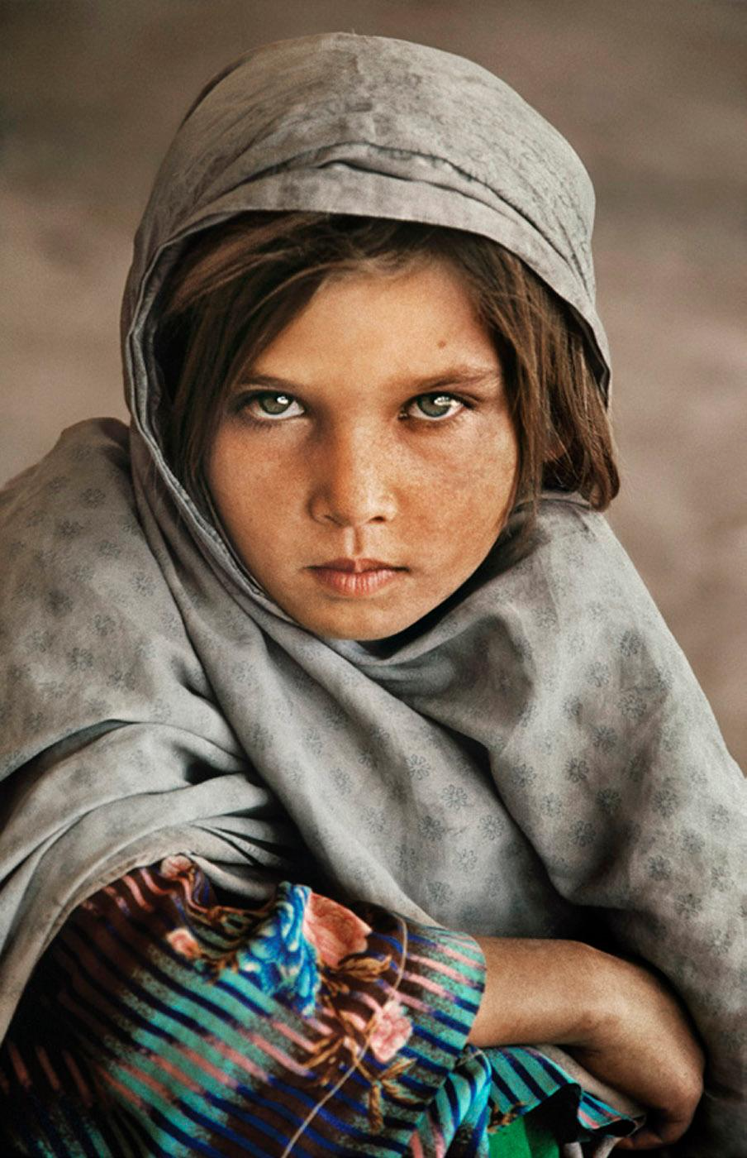
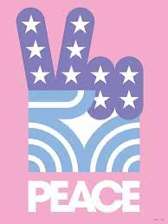
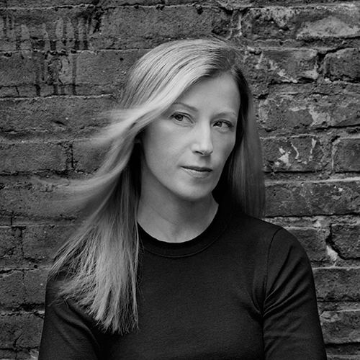
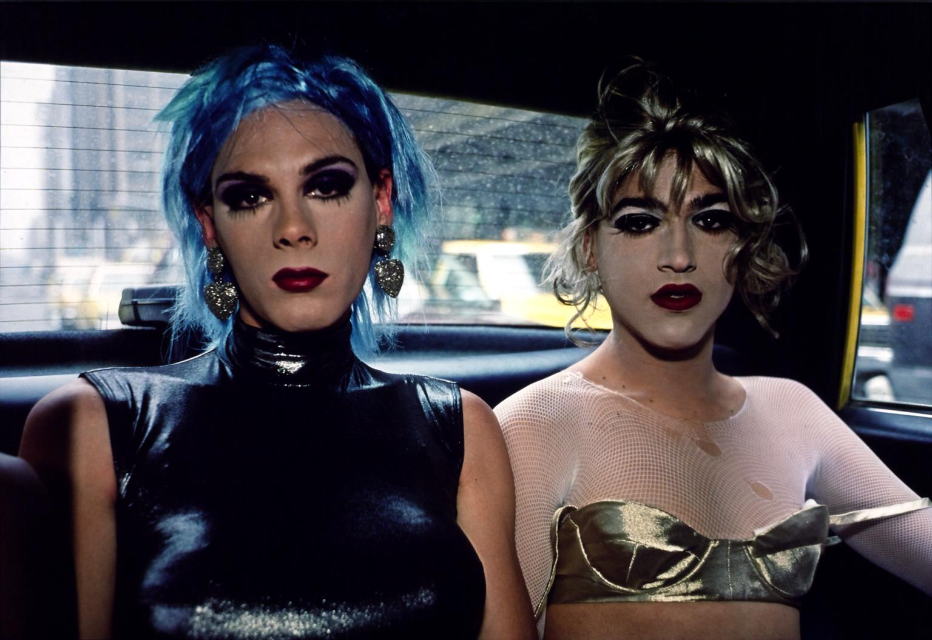
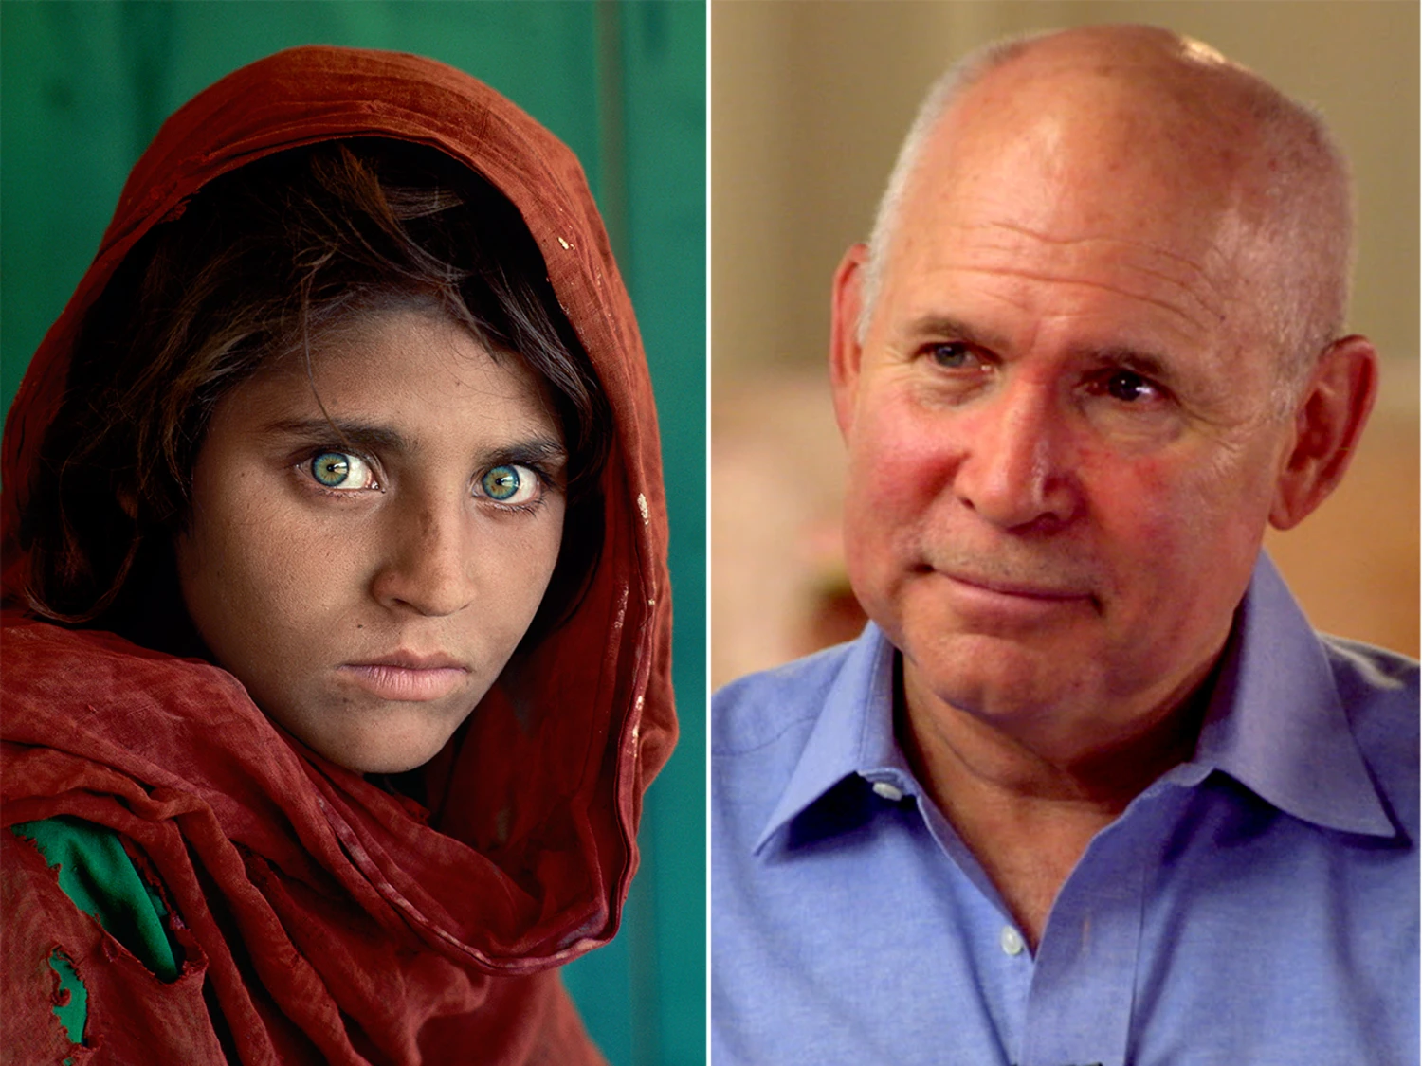
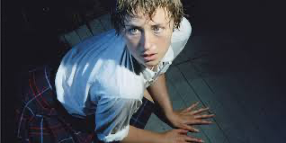
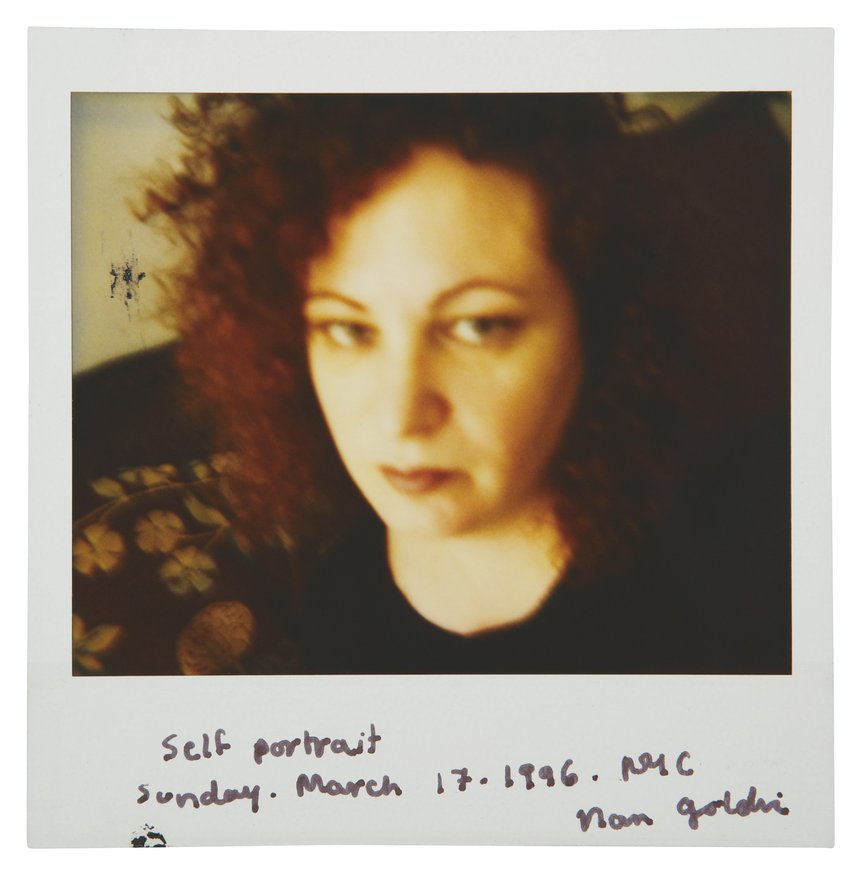
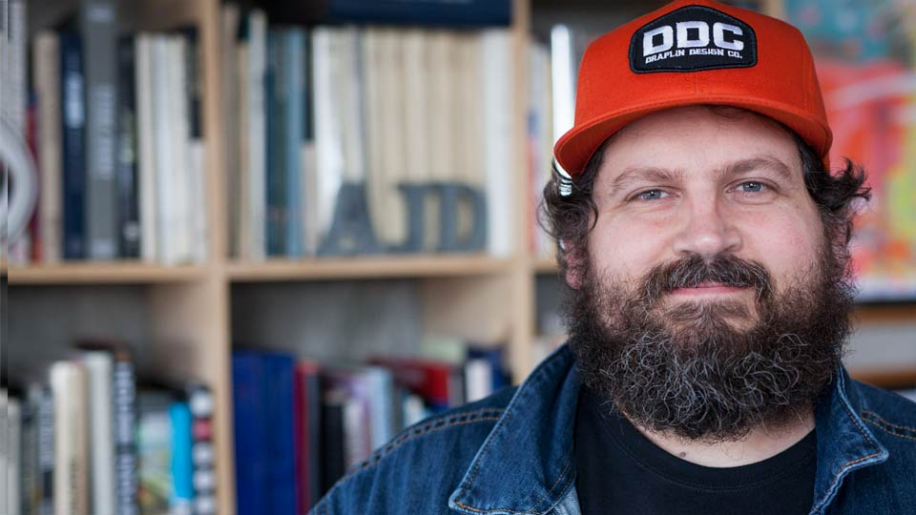
Activism and Photography
Bruce Davidson
Diane Arbus
Gordon Parks
Steve McCurry
Nan Goldin
Aaron Draplin
Cindy Sherman
Nan Goldin

Slide 13
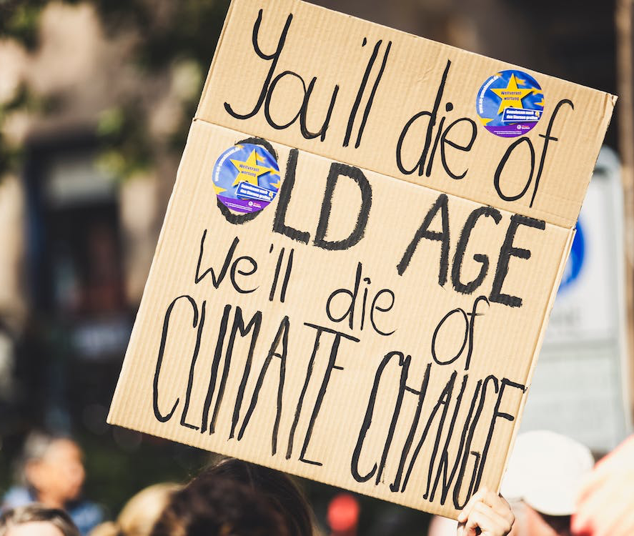
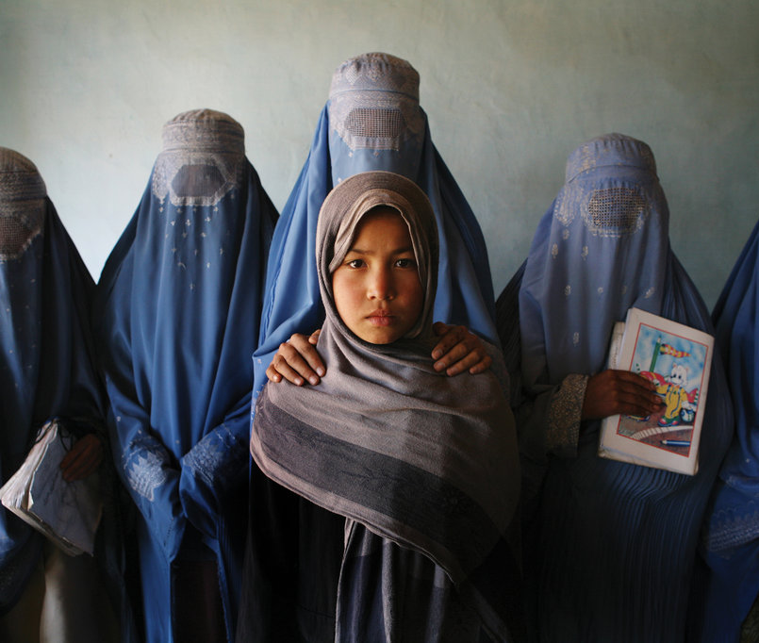
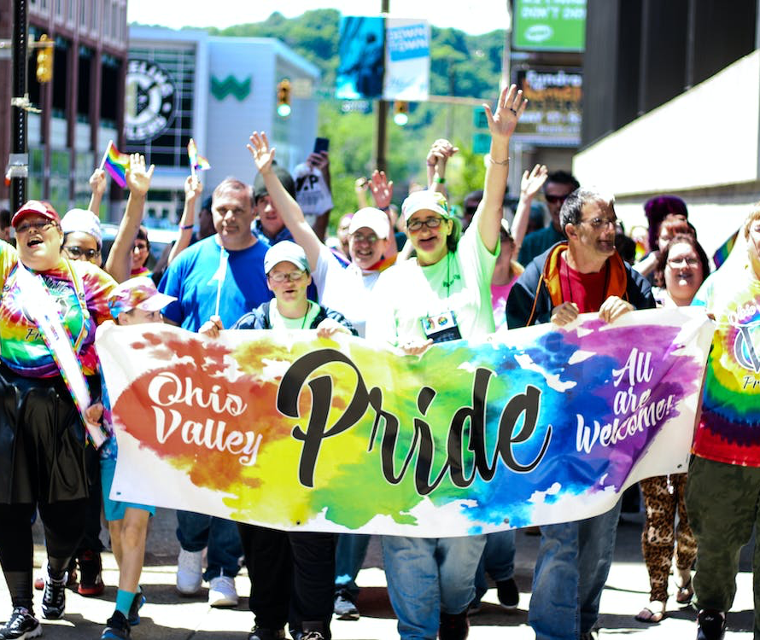
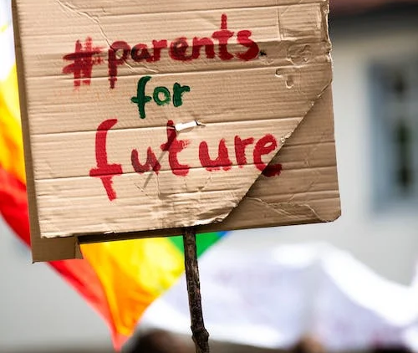
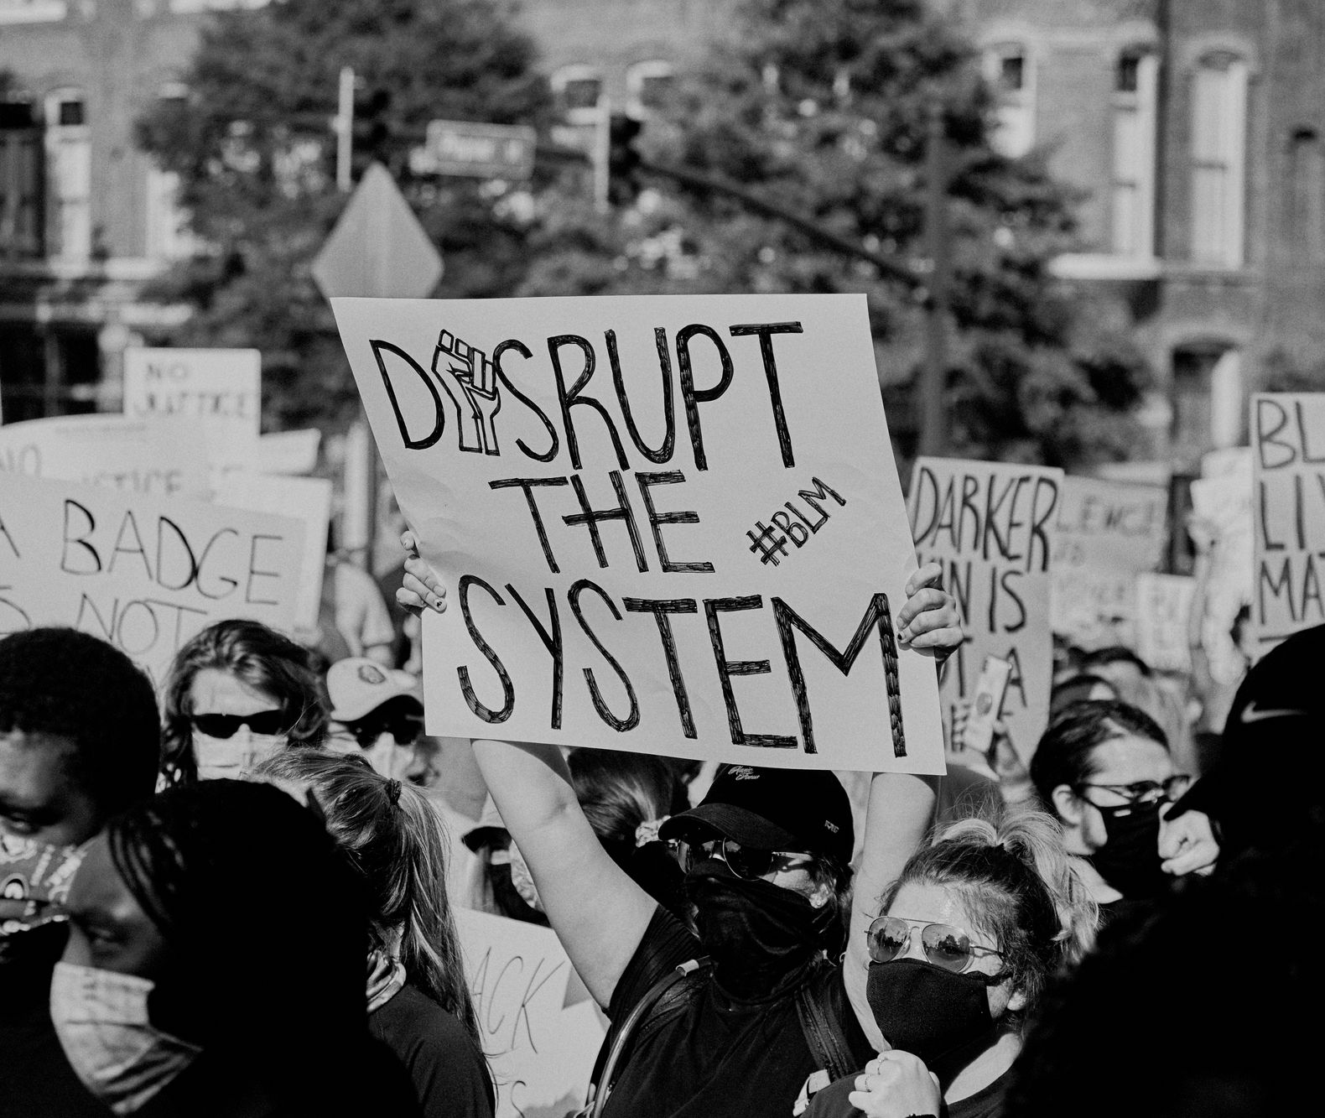
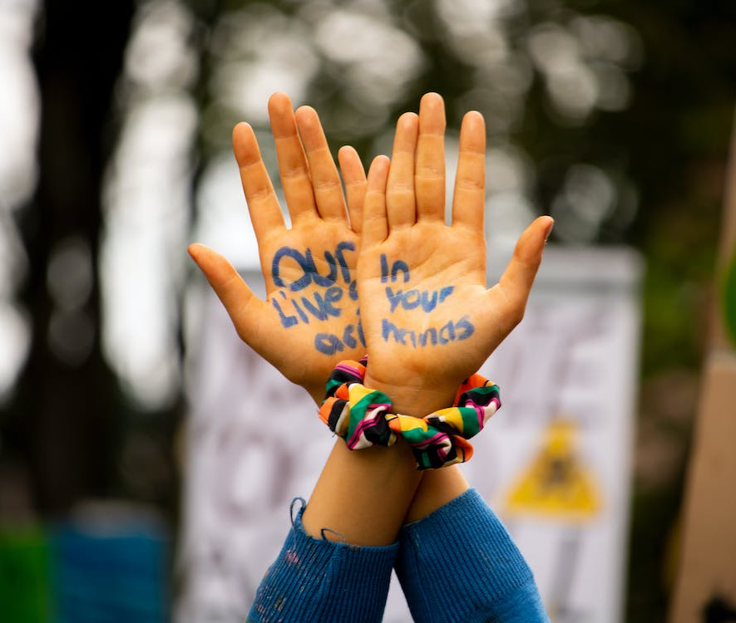

Slide 14
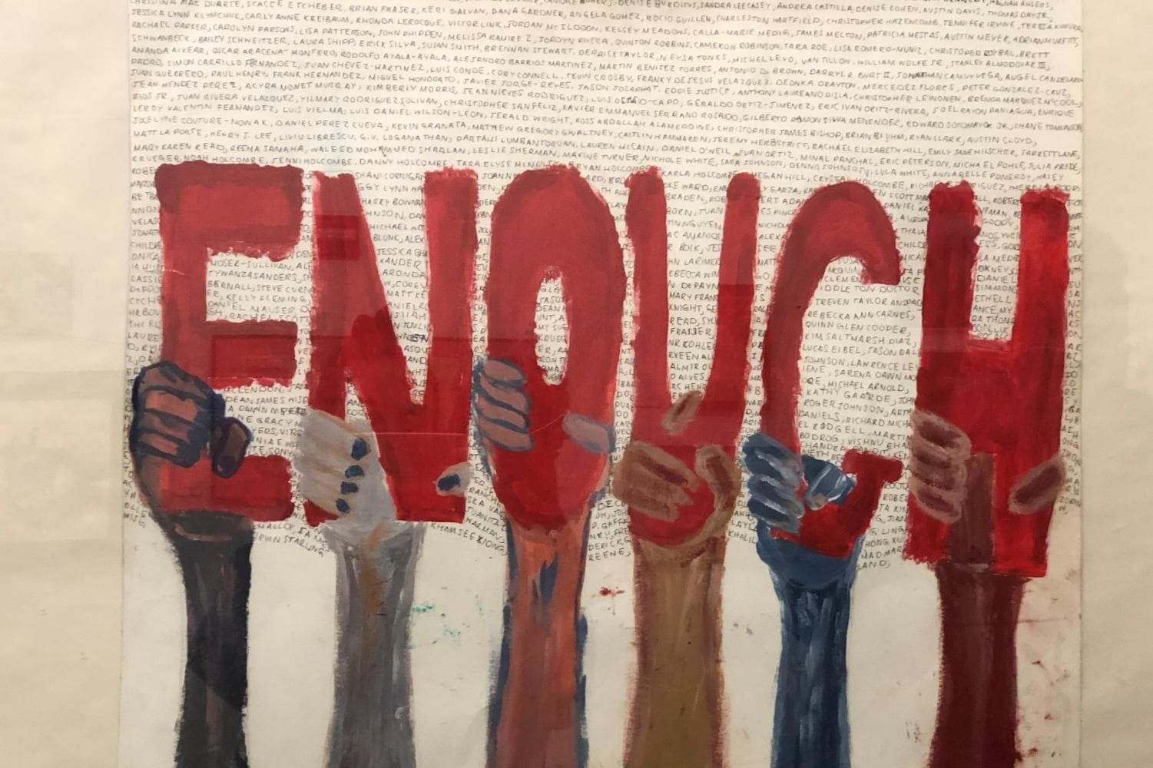
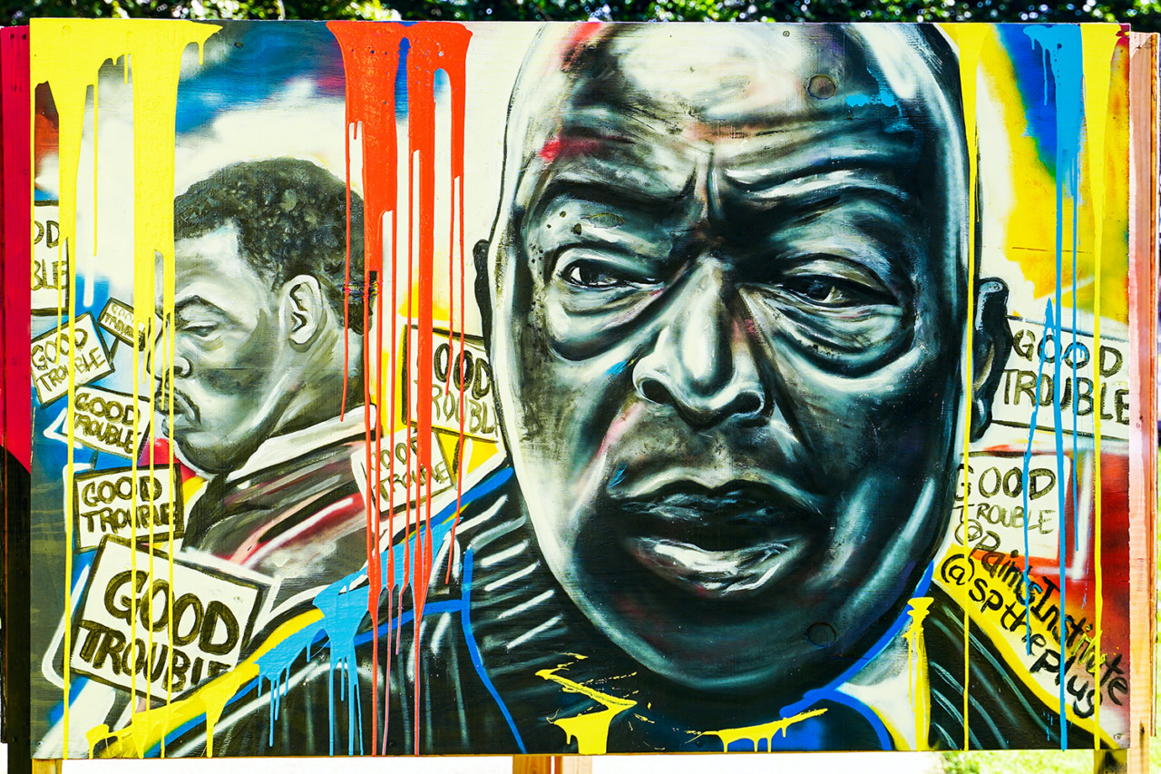
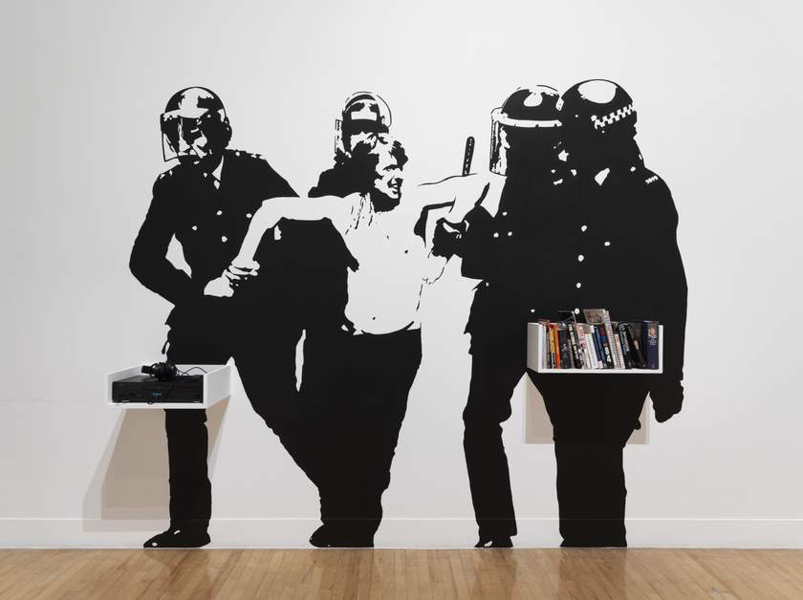
Inspiration

